Slide 1

Innovative Training and Education on Renewable Energy Systems: Towards the Future Resilient, Sustainable and Carbon-Neutral Power Systems
2023 IEEE PES PowerTech Tutorial
25 June 2023

Slide 2
EMT modelling and simulation of grid-forming converter control

Slide 3
Matej (UNIZG) to prepare this section (90mins)

Slide 4


About me
Jan 2017 – May 2023: Research and teaching assistant at UNIZG FER
July 2023 – : Project engineer at HVDC System Performance Department, Hitachi Energy
Primary research area: Frequency dynamics of low-inertia systems and model order reduction for system frequency response studies
Contact: matej.krpan@fer.hr

Slide 5
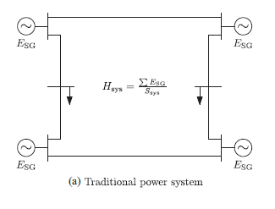
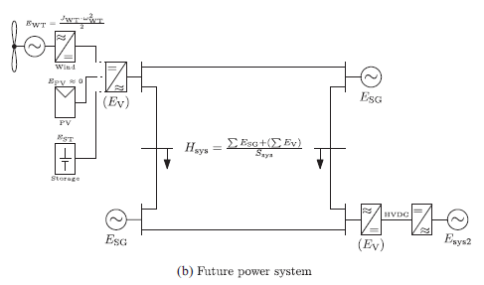
About the tutorial
Significant penetration of converter-interfaced devices (CID)
Grid-forming voltage source converters (VSCs): one of the solutions for enabling high share of RES/CID
EMT simulations might be required for specific power system studies in the future
Source: P. Tielens and D. Van Hertem, “The relevance of inertia in power systems,” Renew. Sustain. Energy Rev., vol. 55, pp. 999–1009, 2016.

Slide 6
About the tutorial
For beginners
Basic understanding of RMS/EMT simulations
EMT average model of a VSC controlled as a VSM (virtual synchronous machine)
Commercial power system analysis software (PowerFactory 2022 SP4)
Material will be available

Slide 7
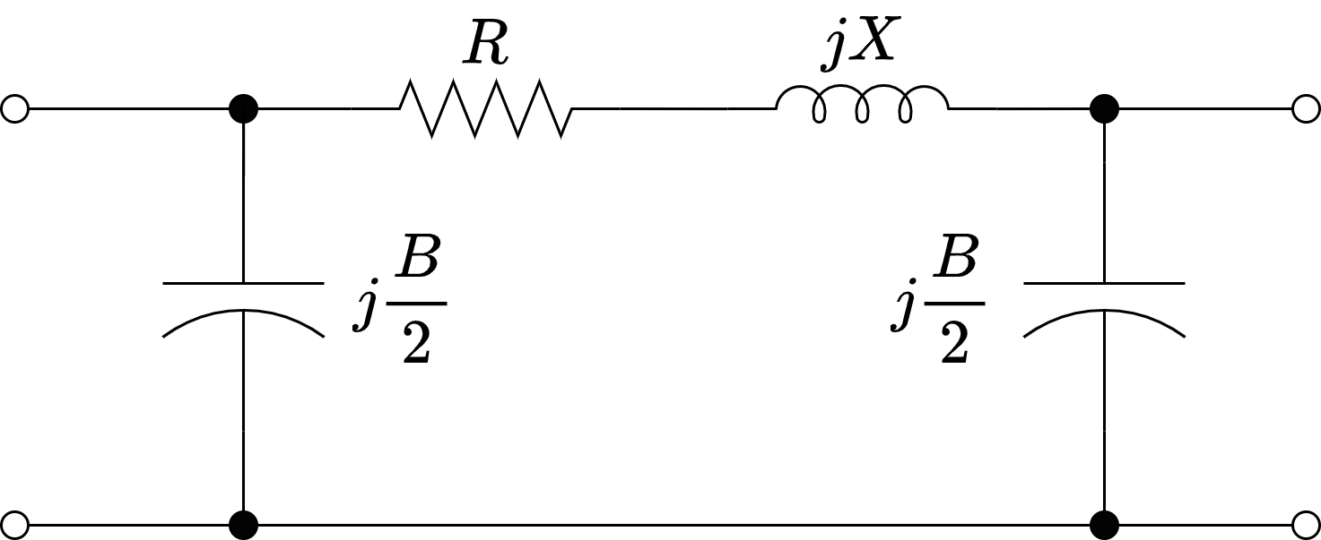
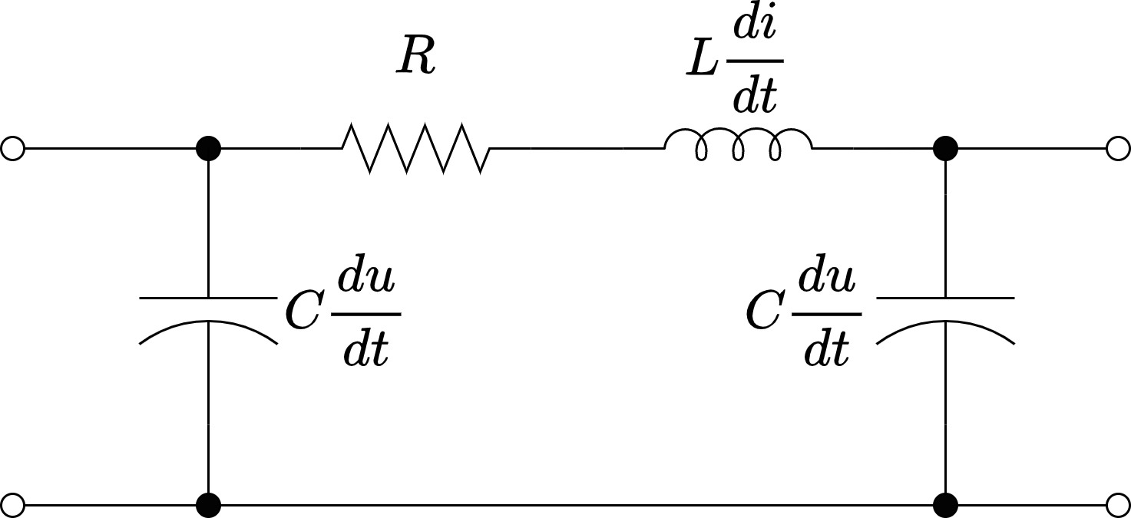
Refresher course
RMS | EMT
Grid dynamics neglected (phasors) | Grid dynamics considered (differential equations)
Algebraic equations: machine stator, transformers, lines, shunt elements | Algebraic equations: -
Diff. equations: machine rotor, control systems | Diff. equations: Everything
Step size: 1 – 10 ms, bulk systems | Step size: 1 – 100 μs, small systems

Slide 8
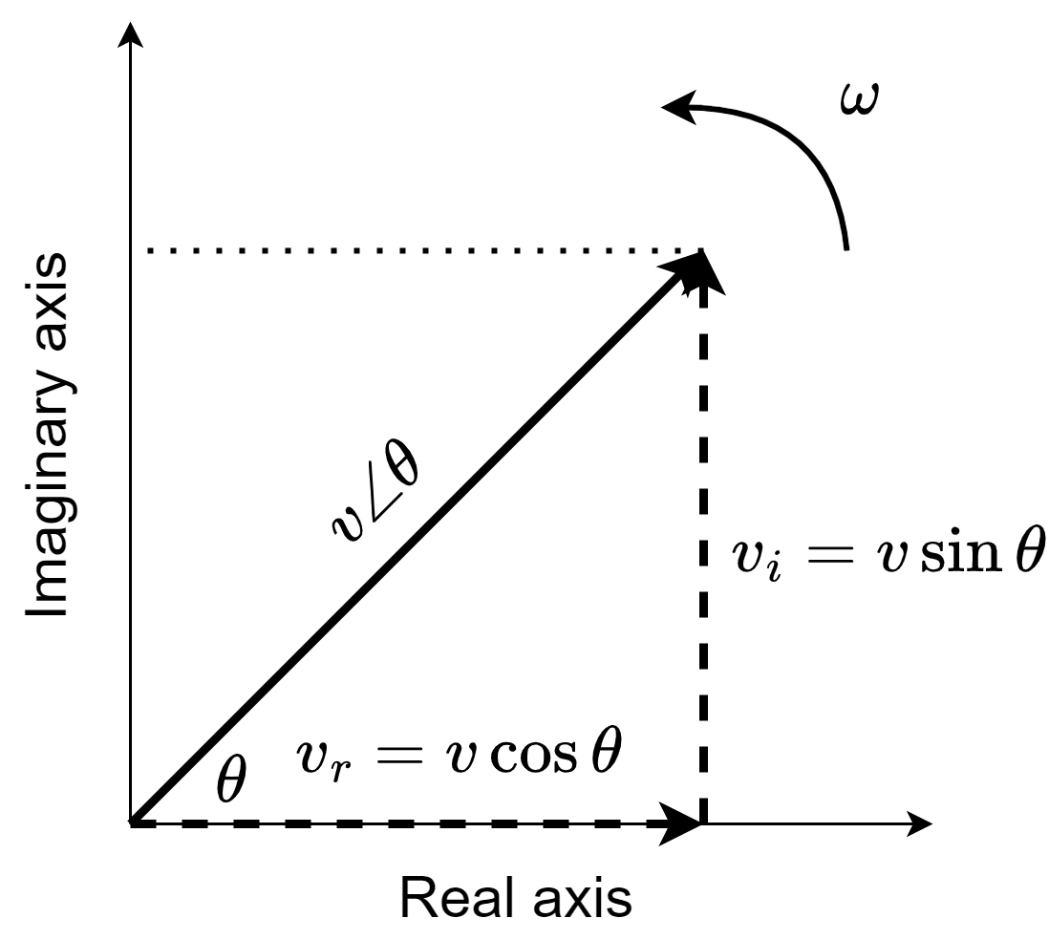
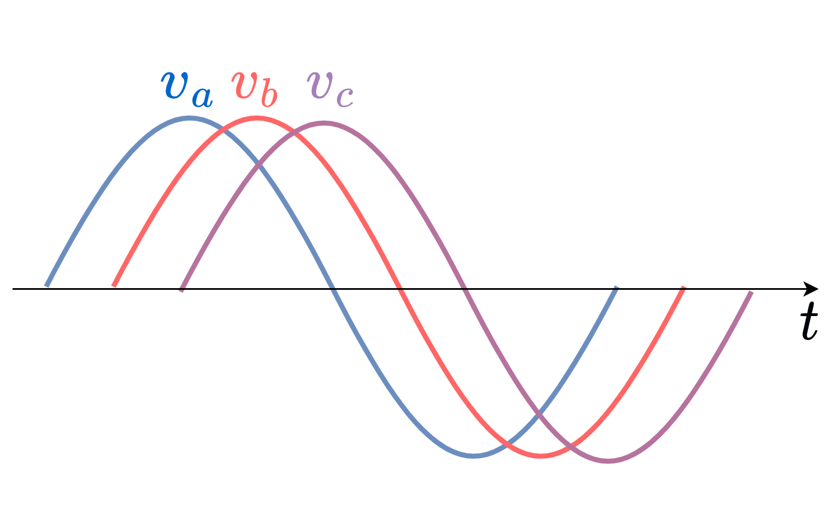
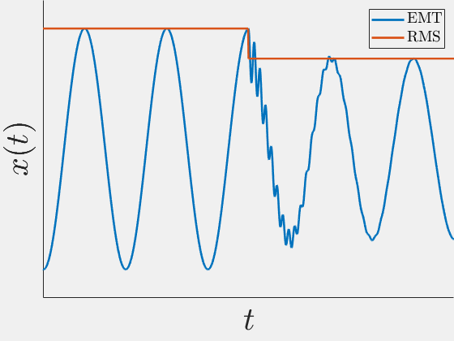
Refresher course
RMS | EMT
Domain: real-imaginary | Domain: abc

Slide 9
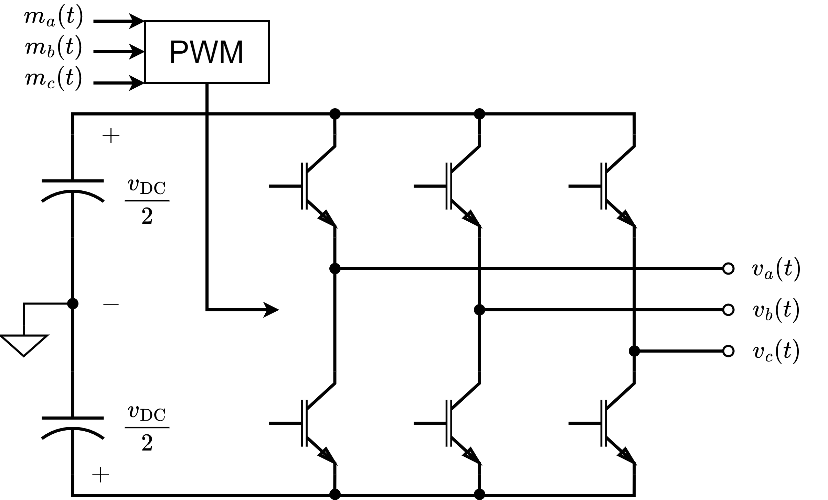
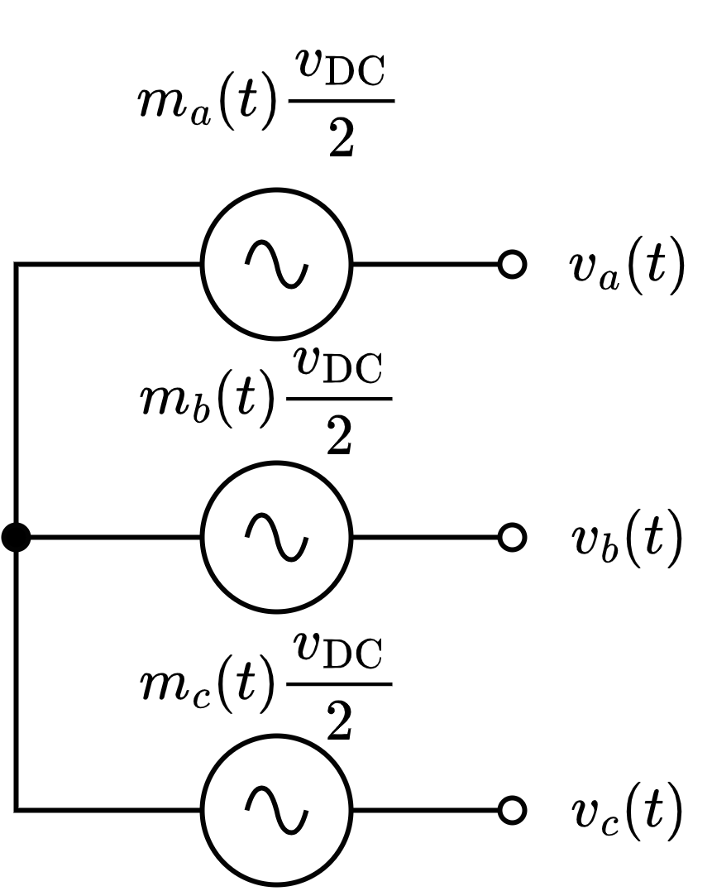
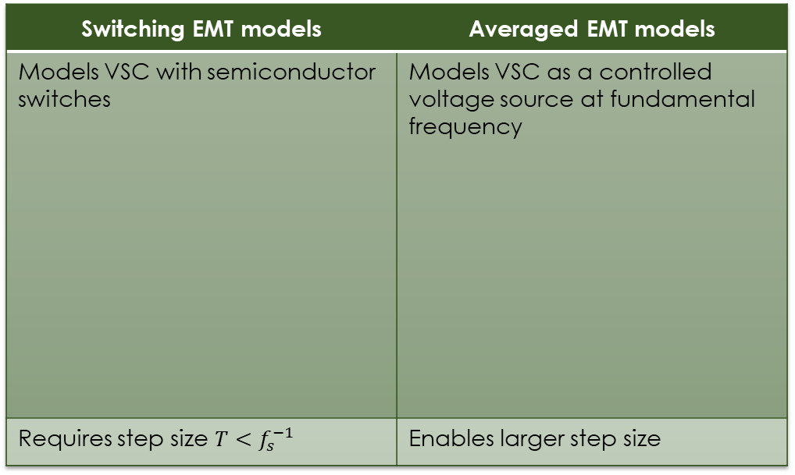
Refresher course
Switching EMT models | Averaged EMT models
Models VSC with semiconductor switches | Models VSC as a controlled voltage source at fundamental frequency
Requires step size $T<f_{s}^{−1}$ | Enables larger step size

Slide 10
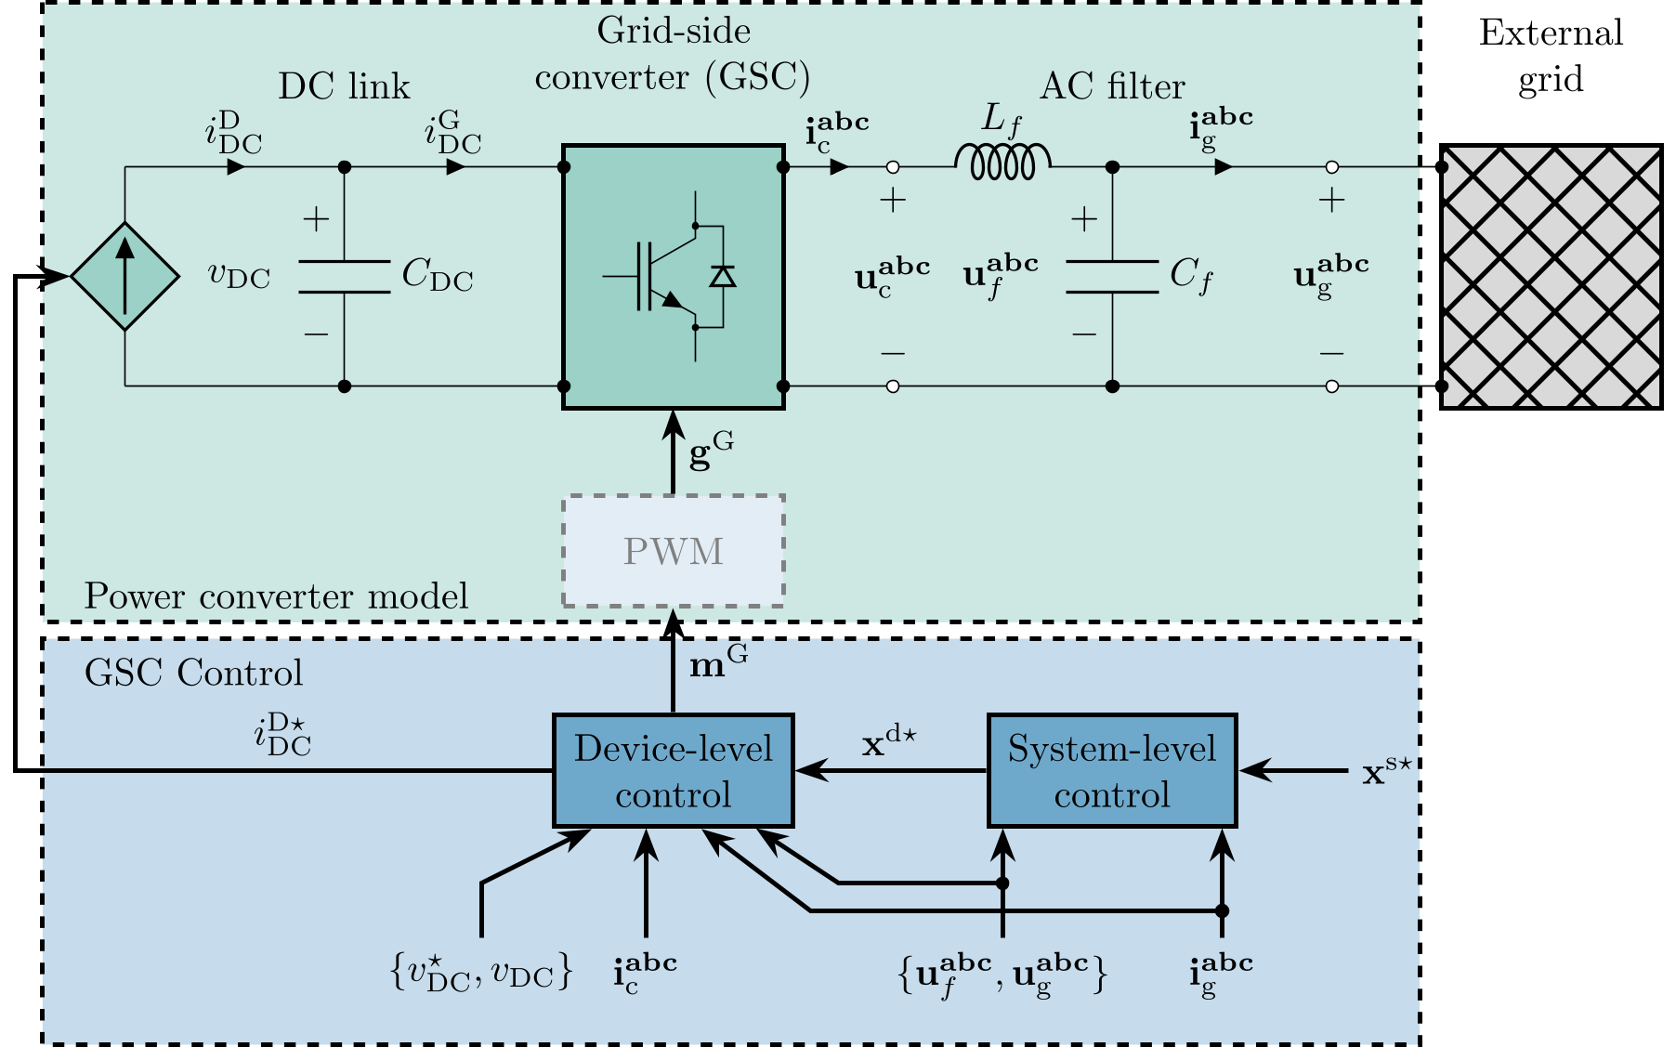
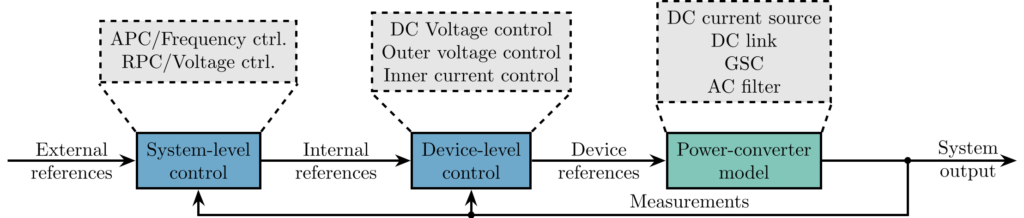
Let’s get started
Choosing the size of the converter
Per-unit base values
AC filter design
Control system design + Model initialization
Time-domain simulations

Slide 11
Choosing the size of the converter
Choosing the size of the converter
Per-unit base values
AC filter design
Control system design + Model initialization
Time-domain simulations

Slide 12
Choosing the size of the converter
Arbitrary
100 MVA converter
400 kV point of common coupling (PCC)
Connection to an infinite bus one 100 km 400 kV overhead line

Slide 13
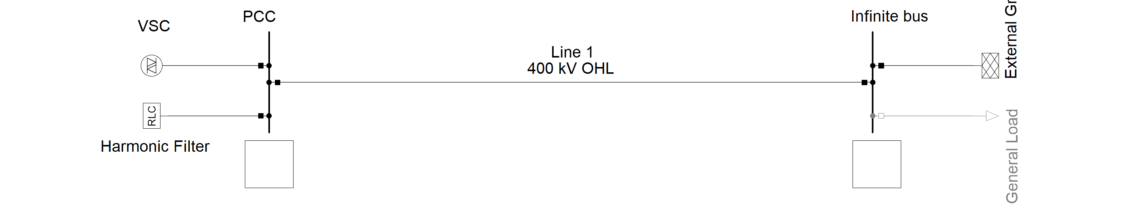
Choosing the size of the converter

Slide 14
Per-unit base values
Choosing the size of the converter
Per-unit base values
AC filter design
Control system design + Model initialization
Time-domain simulations

Slide 15
Per-unit base values
We have both AC and DC quantities
Careful selection of base values to be mathematically consistent
We will use line-to-neutral peak values of AC side quantities

Slide 16
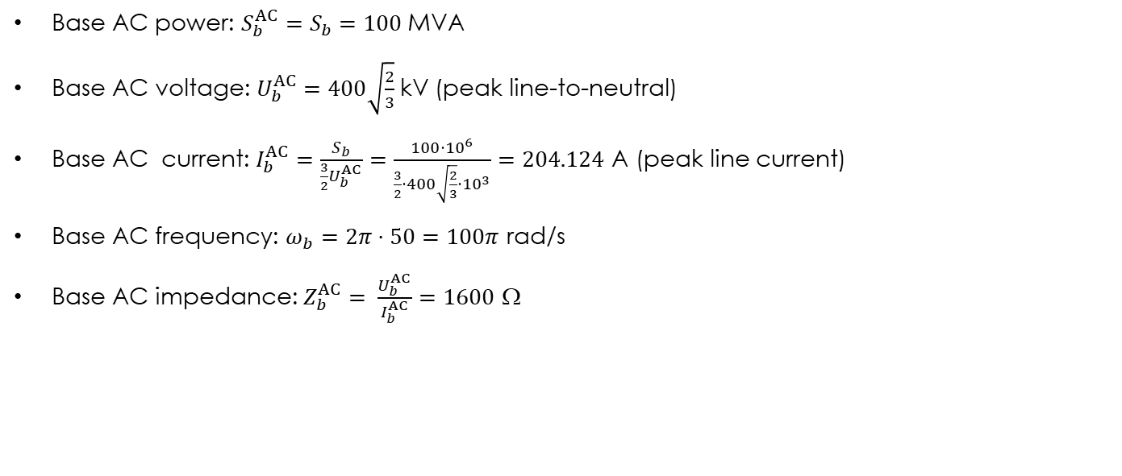

Per-unit base values
VSC nominal power: $S_{n}=100$MVA
VSC nominal voltage: $U_{n}=400$kV (RMS line-to-line)
Base AC power: $S_{b}^{AC}=S_{b}=100$MVA
Base AC voltage: $U_{b}^{AC}=400\sqrt{\frac{2}{3}}$kV (peak line-to-neutral)
Base AC current: $I_{b}^{AC}=\frac{S_{b}}{\frac{3}{2}U_{b}^{AC}}=\frac{100⋅{10}^{6}}{\frac{3}{2}⋅400\sqrt{\frac{2}{3}}⋅{10}^{3}}=204.124$ A (peak line current)
Base AC frequency: $ω_{b}=2π⋅50=100π$ rad/s
Base AC impedance: $Z_{b}^{AC}= \frac{U_{b}^{AC}}{I_{b}^{AC}}=1600$ Ω

Slide 17
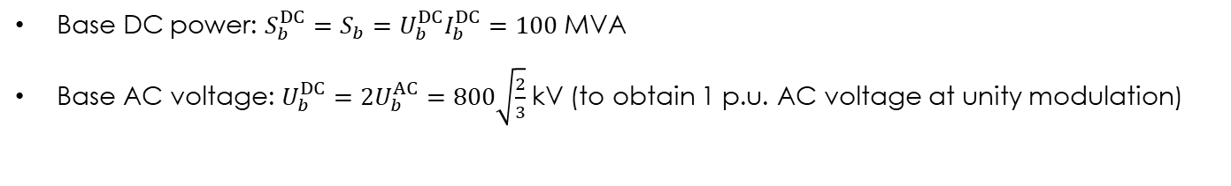
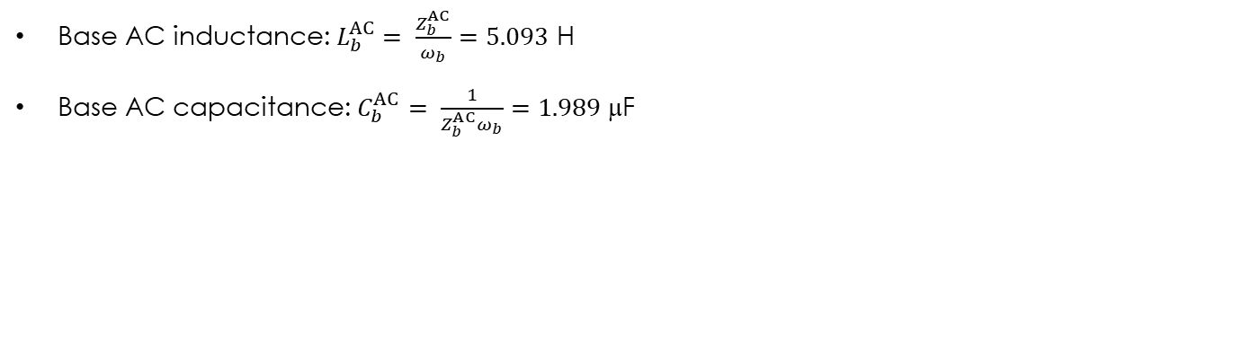
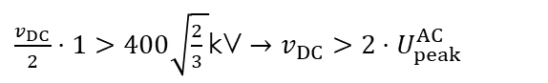
Per-unit base values
Base AC inductance: $L_{b}^{AC}= \frac{Z_{b}^{AC}}{ω_{b}}=5.093$ H
Base AC capacitance: $C_{b}^{AC}= \frac{1}{Z_{b}^{AC}ω_{b}}=1.989$ μF
Base DC power: $S_{b}^{DC}=S_{b}=U_{b}^{DC}I_{b}^{DC}=100$MVA
Base AC voltage: $U_{b}^{DC}=2U_{b}^{AC}=800\sqrt{\frac{2}{3}}$kV (to obtain 1 p.u. AC voltage at unity modulation)
$$m\left(t\right)= \hat{m}\left(t\right)\cos\left(ωt+θ\right), \hat{m}\left(t\right), m(t)∈\left[−1, 1\right]$$
$\frac{v_{DC}}{2}⋅1>400\sqrt{\frac{2}{3} }$kV $→v_{DC}>2⋅U_{peak}^{AC}$

Slide 18
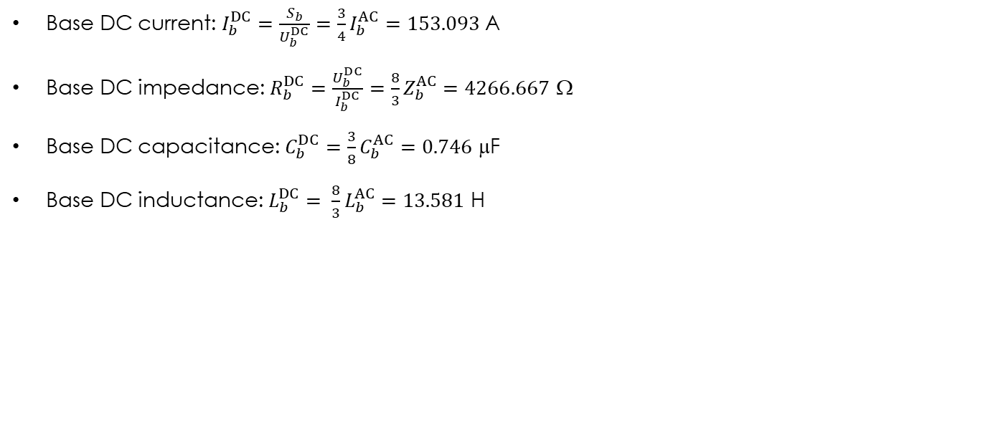
Per-unit base values
Base DC current: $I_{b}^{DC}=\frac{S_{b}}{U_{b}^{DC}}=\frac{3}{4}I_{b}^{AC}=153.093$A
Base DC impedance: $R_{b}^{DC}=\frac{U_{b}^{DC}}{I_{b}^{DC}}=\frac{8}{3}Z_{b}^{AC}=4266.667$ Ω
Base DC capacitance: $C_{b}^{DC}=\frac{3}{8}C_{b}^{AC}=0.746$ $\text{}\text{F}$
Base DC inductance: $L_{b}^{DC}= \frac{8}{3}L_{b}^{AC}=13.581$ H

Slide 19
AC filter design
Choosing the size of the converter
Per-unit base values
AC filter design
Control system design + Model initialization
Time-domain simulations

Slide 20
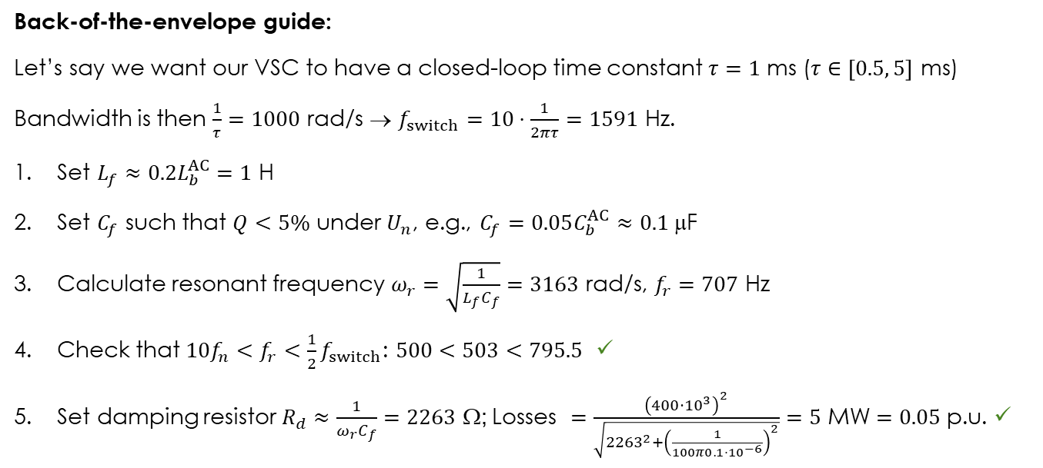
AC filter design
Back-of-the-envelope guide:
Let’s say we want our VSC to have a closed-loop time constant $τ=1$ ms ($τ∈\left[0.5, 5\right]$ ms)
Bandwidth is then $\frac{1}{τ}=1000$ rad/s → $f_{switch}=10⋅\frac{1}{2πτ}=1591$ Hz.
Set $L_{f}≈0.2L_{b}^{AC}=1$ H
Set $C_{f}$ such that $Q<5\%$ under $U_{n}$, e.g., $C_{f}=0.05C_{b}^{AC}≈0.1$ μF
Calculate resonant frequency $ω_{r}=\sqrt{\frac{1}{L_{f}C_{f}}}=3163$ rad/s, $f_{r}=707$ Hz
Check that ${10f_{n}<f}_{r}<\frac{1}{2}f_{switch}$: $500<503<795.5$ ✓
Set damping resistor $R_{d}≈\frac{1}{ω_{r}C_{f}}=2263$ Ω; Losses $=\frac{{\left(400⋅{10}^{3}\right)}^{2}}{\sqrt{{2263}^{2}+{\left(\frac{1}{100π0.1⋅{10}^{−6}}\right)}^{2}}}=5$ MW $=0.05$ p.u. ✓

Slide 21

AC filter design
If everything was done correctly, usual values are:
$$L_{f}≈0.1−0.3 p.u.$$
$$C_{f}<0.1 p.u.$$

Slide 22
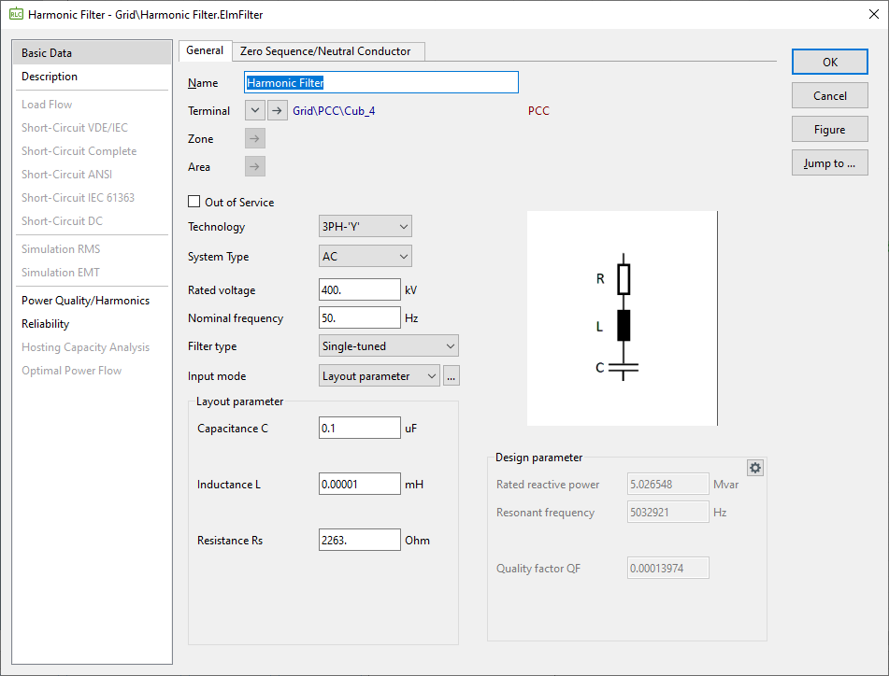
AC filter design

Slide 23
Control system design
Choosing the size of the converter
Per-unit base values
AC filter design
Control system design + Model initialization
Time-domain simulations

Slide 24
Composite model frame
First we need to create a Composite Model Frame
To define slots with inputs and outputs for internal controllers and elements
To define signal routing between different elements of the control system
Created inside Project > Library > Dynamic models or Project > Library > User defined models

Slide 25
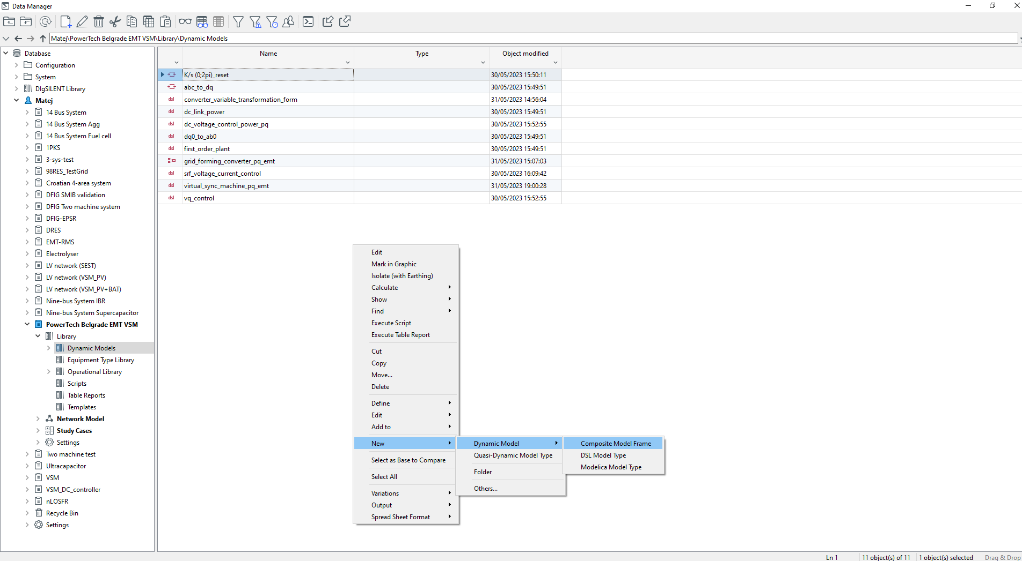
Composite model frame

Slide 26
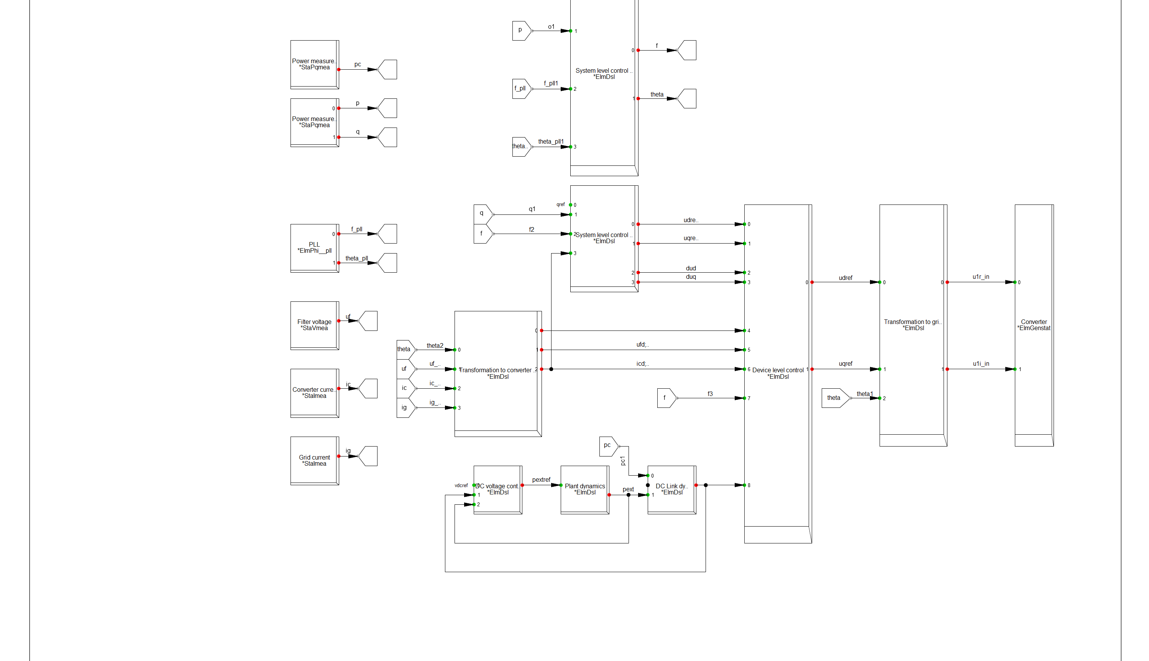
Composite model frame

Slide 27
Composite model frame
SLOT | DESCRIPTION | CLASS | INPUTS | OUTPUTS
Converter | Static generator element in the grid | *ElmGenstat | u1r_in, u1i_in
dq → αβ0 transformation |  | *ElmDsl | udref, uqref, theta | uref_alpha, uref_beta
abc → dq0 transformation |  | *ElmDsl | theta, uf_A; uf_B; uf_C, ic_A; ic_B; ic_C, ig_A; ig_B; ig_C | igd; igq, ufd; ufq, icd; icq
Device level control | Outer voltage / inner current control loops | *ElmDsl | udrefi,uqrefi, dud,duq,igd;igq, ufd;ufq,icd;icq, f,vdc | udref, uqref
System level control – Active power control | VSM emulation | *ElmDsl | pref, p, f_pll, theta_pll | f, theta
System level control – AC voltage control | Voltage reference with Q droop and threshold virtual impedance | *ElmDsl | qref, q, f, icd; icq | udrefi, uqrefi, dud, duq

Slide 28
Composite model frame
SLOT | DESCRIPTION | CLASS | INPUTS | OUTPUTS
DC voltage control | DC link voltage control | *ElmDsl | vdcref, vdc, pext | pextref
Plant dynamics | External plant dynamics model | *ElmDsl | pextref | pext
DC link dynamics | DC link dynamics | *ElmDsl | pc,pext | vdc
PLL | Phase-locked loop | *ElmPhi__pll |  | fmeas, x2 (theta_pll)
Power measurement - converter | PQ measurement device | *StaPqmea |  | P
Power measurement - grid | PQ measurement device | *StaPqmea |  | P, q

Slide 29
Composite model frame
SLOT | DESCRIPTION | CLASS | INPUTS | OUTPUTS
Filter voltage measurement |  | *StaVmea |  | u_A;u_B;u_C
Converter current measurement |  | *StaImea |  | i_A;i_B;i_C
Grid current measurement |  | *StaImea |  | i_A;i_B;i_C

Slide 30
DSL model types
Now we can define the DSL model types that will go inside the slots
Internal structure of the controllers
Names of slots’ input/output variables MUST MATCH the names of input/output variables in DSL model types (case sensitive)
Created inside Project > Library > Dynamic models or Project > Library > User defined models
Can be created from the toolbar via Insert > Dynamic models > DSL model type

Slide 31
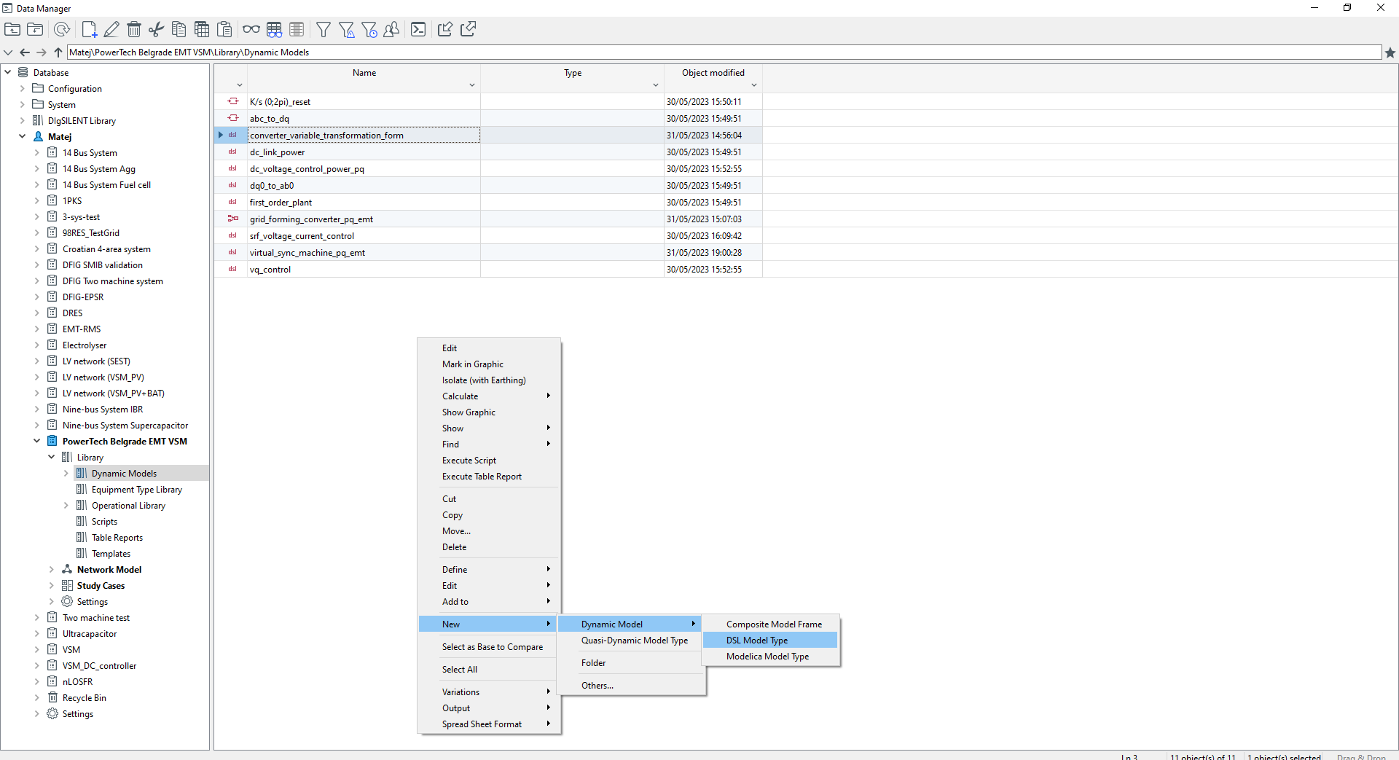
DSL model types

Slide 32
dq → αβ0 transformation

Slide 33

dq → αβ0 transformation
Inverse Park transform
Static generator element takes α and β voltage components as inputs
$$\left(\begin{matrix}x_{α} \\ x_{β}\end{matrix}\right)=\left(\begin{matrix}\cos{θ} & −\sin{θ} \\ \sin{θ} & \cos{θ}\end{matrix}\right)\left(\begin{matrix}x_{d} \\ x_{q}\end{matrix}\right)$$

Slide 34
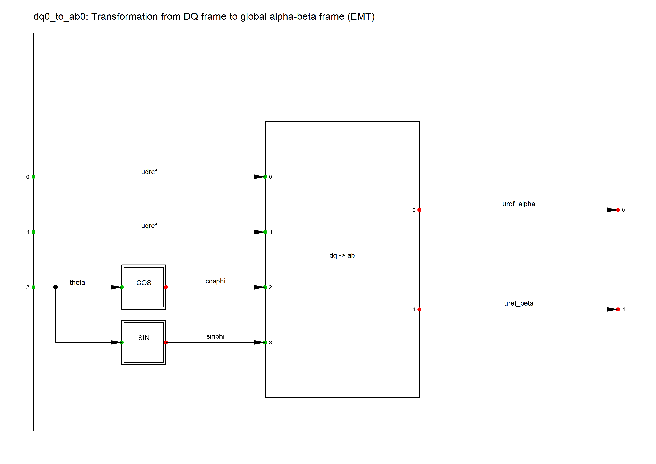
dq → αβ0 transformation

Slide 35
dq → αβ0 transformation

Slide 36
dq → αβ0 transformation

Slide 37
dq → αβ0 transformation

Slide 38

abc → dq0 transformation
Park transform
VSC control in a synchronous reference frame rotating at the speed of the VSM
Power-variant transform
$$\left(\begin{matrix}x_{d} \\ x_{q}\end{matrix}\right)=\frac{2}{3}\left(\begin{matrix}\cos{θ} & \cos{(θ−\frac{2π}{3})} & \cos{(θ+\frac{2π}{3})} \\ −sin{θ} & −sin{(θ−\frac{2π}{3})} & −sin{(θ+\frac{2π}{3})}\end{matrix}\right)\left(\begin{matrix}x_{a} \\ x_{b} \\ x_{c}\end{matrix}\right)$$

Slide 39
abc → dq0 transformation

Slide 40
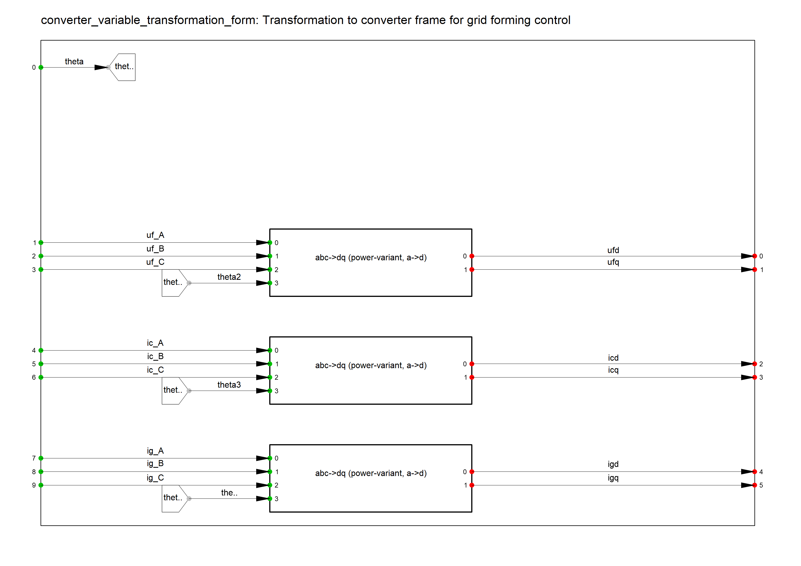
abc → dq0 transformation

Slide 41
abc → dq0 transformation

Slide 42
abc → dq0 transformation

Slide 43
abc → dq0 transformation
! Functionality: This macro implements the power variant forward Park transformatopm (a,b,c)->(d,q)
! It aligns phase a to the d-axis.
! Supports EMT simulation only.
d = 2/3*( cos(theta)*a +cos(theta-twopi()/3)*b+cos(theta+twopi()/3)*c)
q = 2/3*(-sin(theta)*a -sin(theta-twopi()/3)*b-sin(theta+twopi()/3)*c)
inc(d) = 2/3*( cos(theta)*a +cos(theta-twopi()/3)*b+cos(theta+twopi()/3)*c)
inc(q) = 2/3*(-sin(theta)*a -sin(theta-twopi()/3)*b-sin(theta+twopi()/3)*c)

Slide 44
SRF voltage and current controller

Slide 45
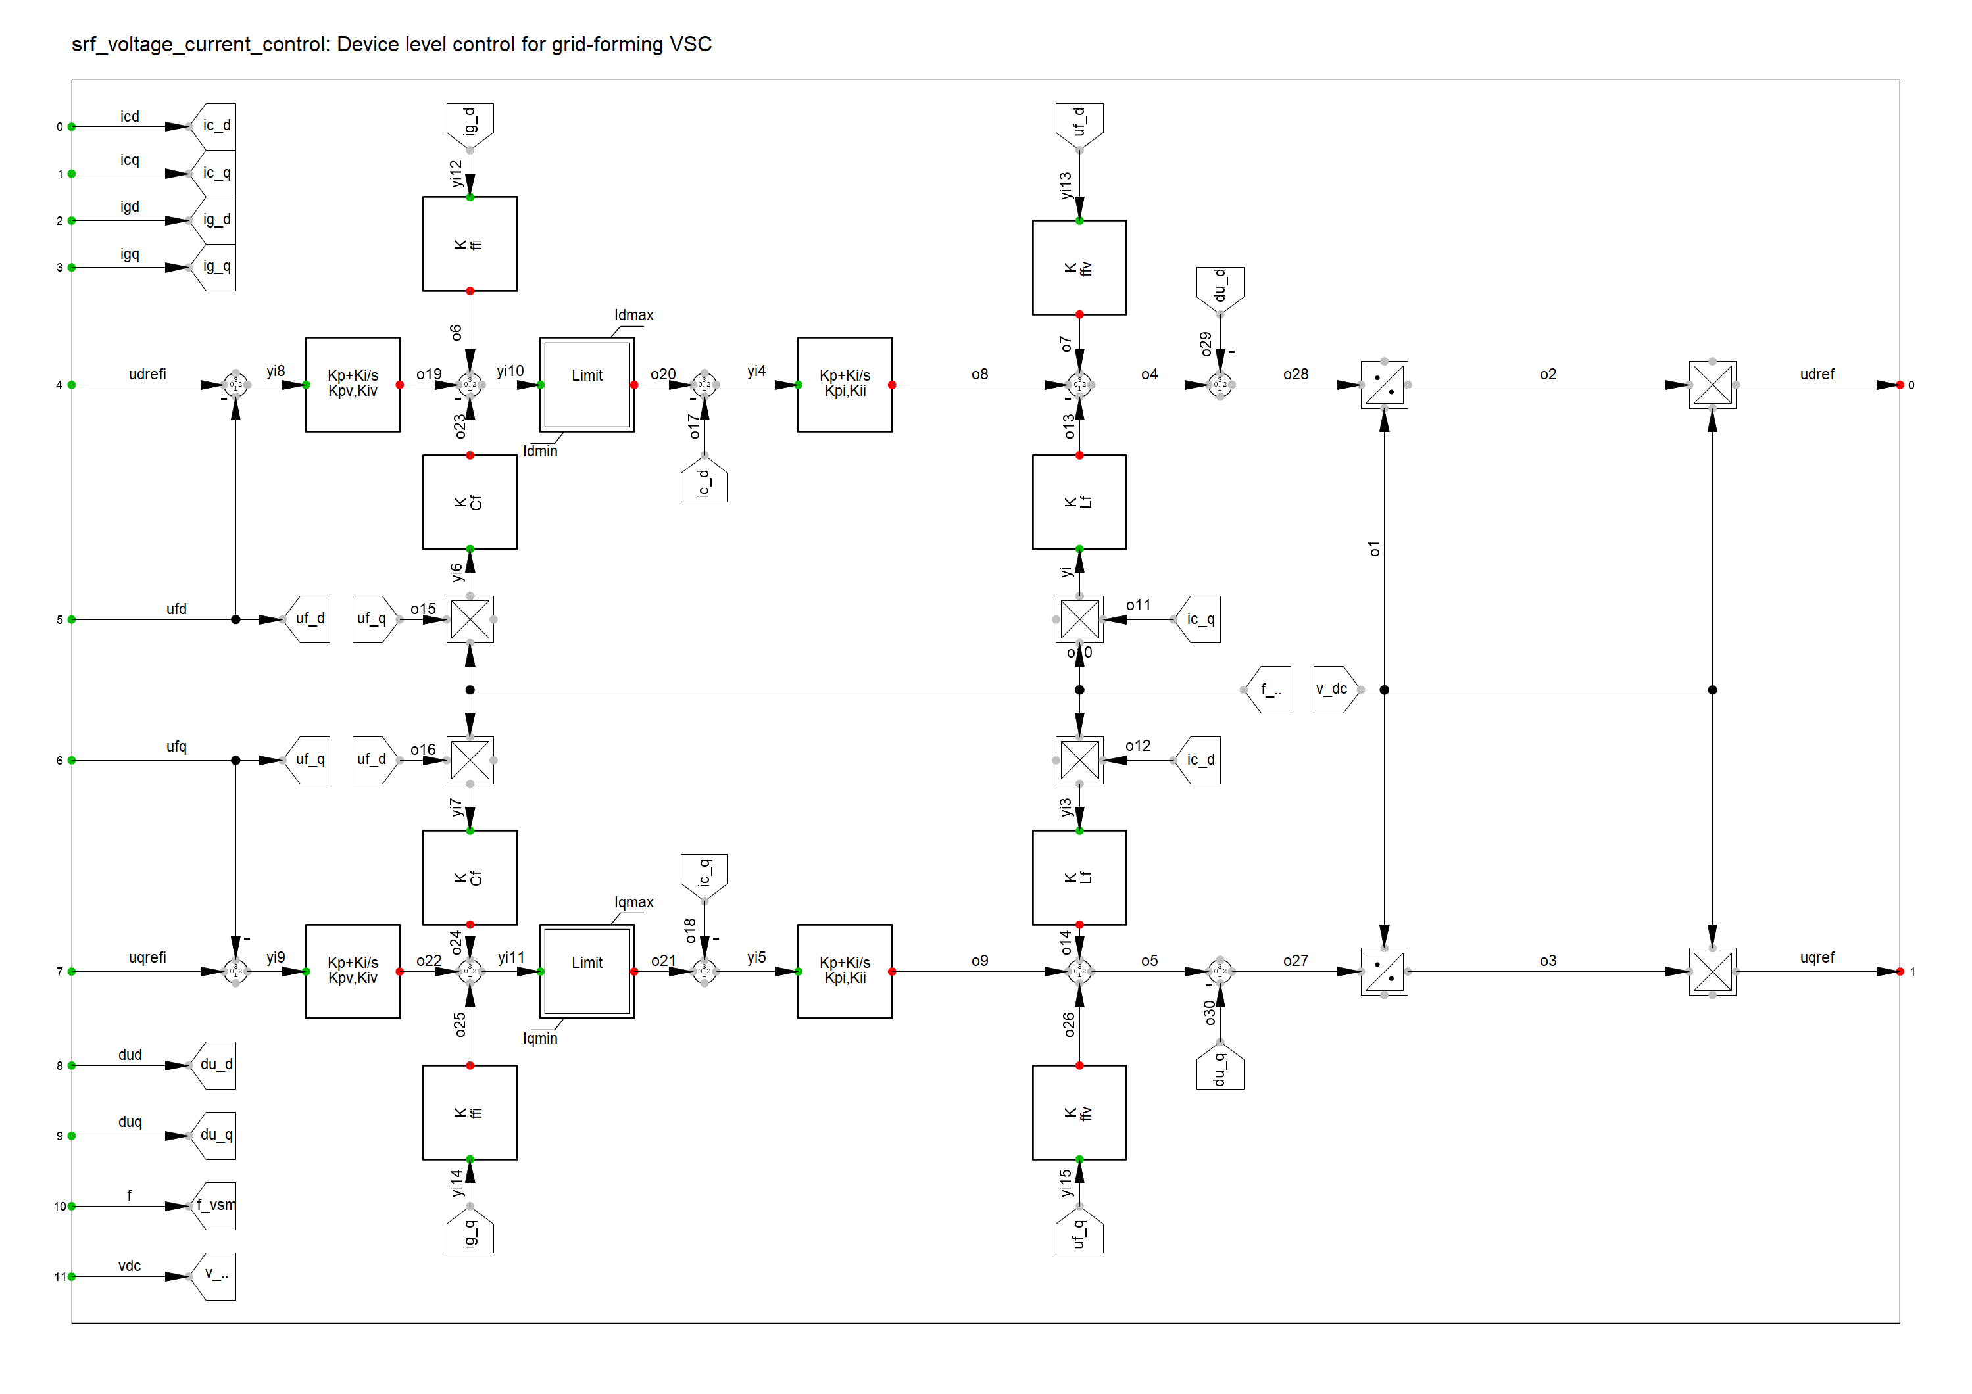
SRF voltage and current controller

Slide 46
SRF voltage and current controller

Slide 47
SRF voltage and current controller

Slide 48
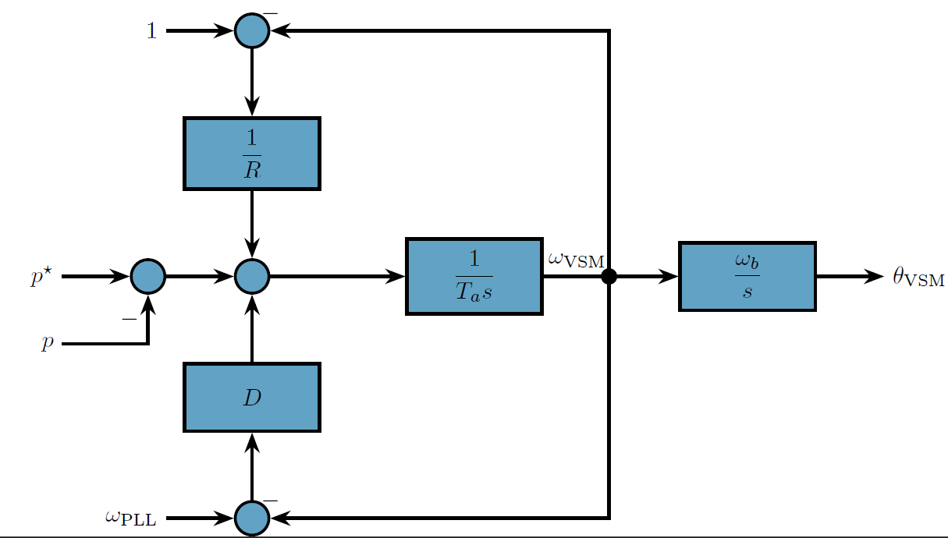
System level control – Active power control

Slide 49
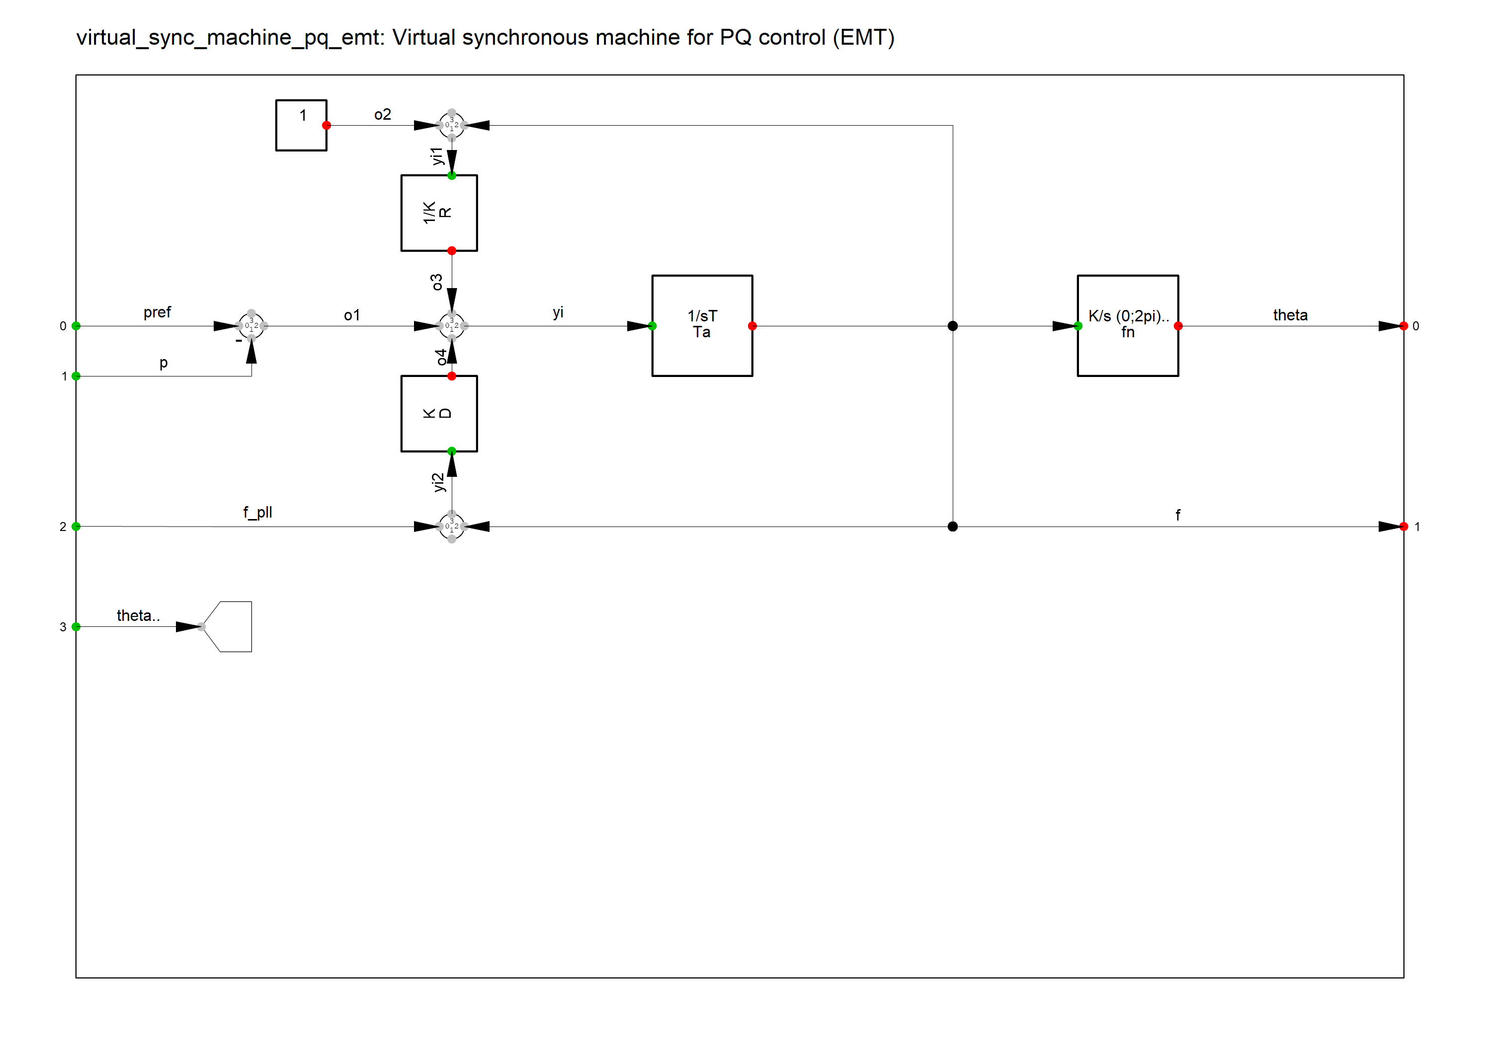
System level control – Active power control

Slide 50
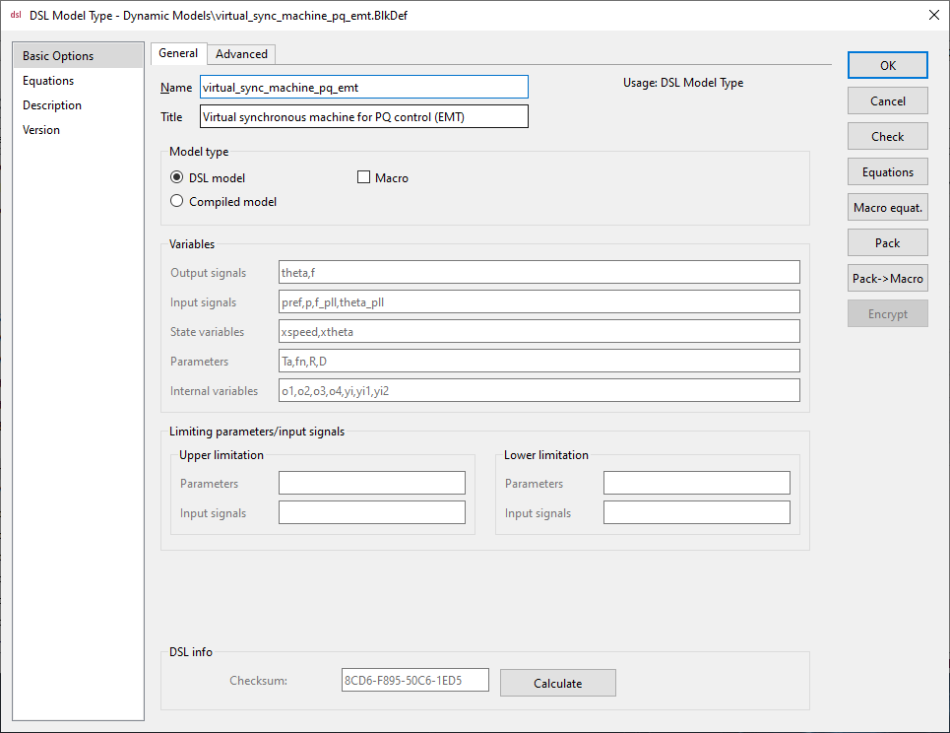
System level control – Active power control

Slide 51
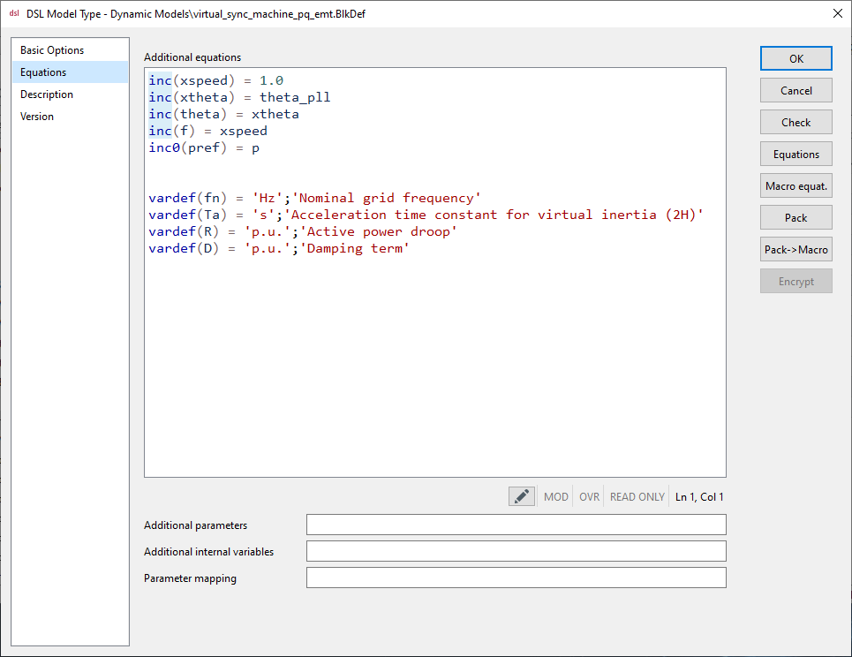
System level control – Active power control

Slide 52
System level control – Active power control
inc(xspeed) = 1.0
inc(xtheta) = theta_pll
inc(theta) = xtheta
inc(f) = xspeed
inc0(pref) = p

Slide 53
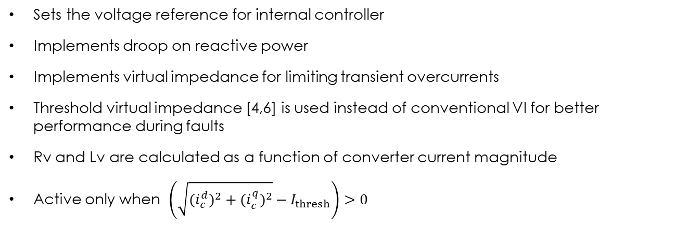

System level control – AC voltage control
Sets the voltage reference for internal controller
Implements droop on reactive power
Implements virtual impedance for limiting transient overcurrents
Threshold virtual impedance [4,6] is used instead of conventional VI for better performance during faults
Rv and Lv are calculated as a function of converter current magnitude
Active only when $\left(\sqrt{{{(i}_{c}^{d})}^{2}+{{(i}_{c}^{q})}^{2}}−I_{thresh}\right)>0$
$$R_{v}=K_{r}\left\|\sqrt{{{(i}_{c}^{d})}^{2}+{{(i}_{c}^{q})}^{2}}−I_{thresh}\right\|$$
$$L_{v}=K_{l}R_{V}$$

Slide 54
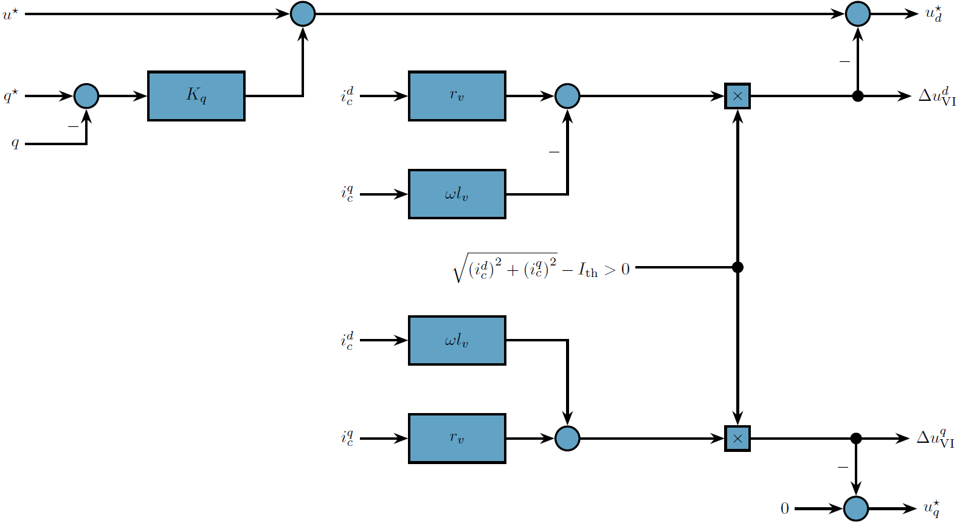
System level control – AC voltage control

Slide 55
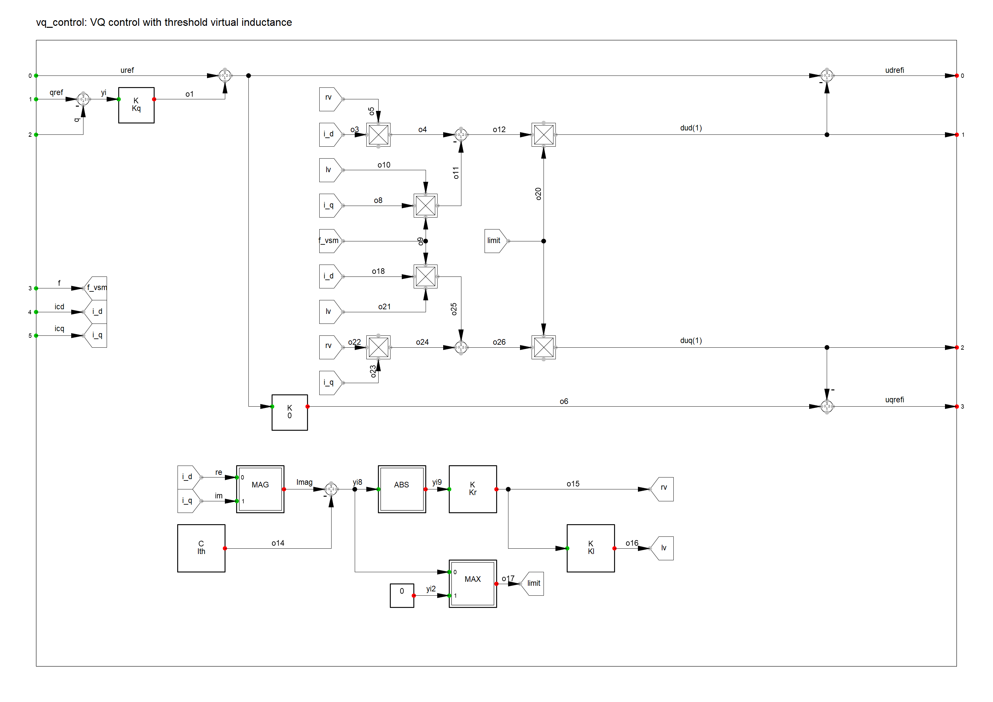
System level control – AC voltage control

Slide 56
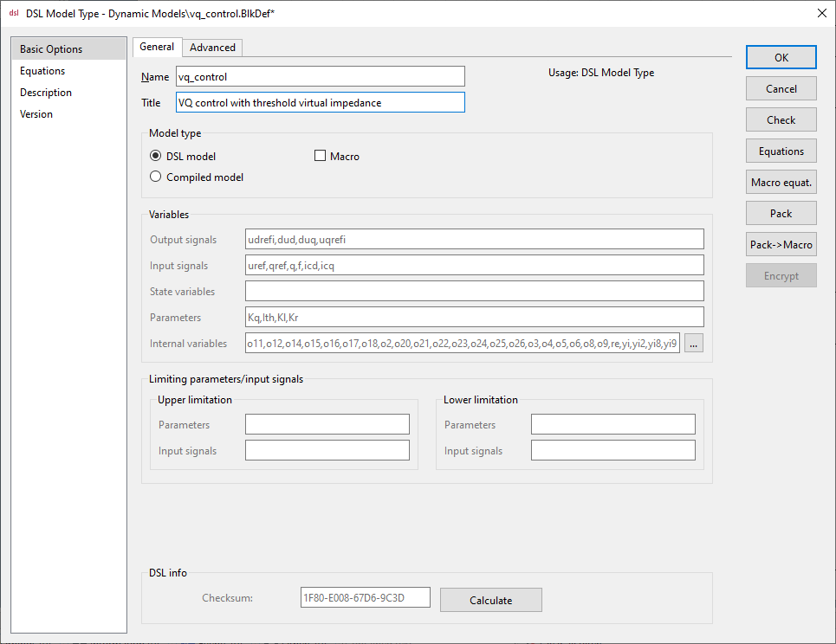
System level control – AC voltage control

Slide 57
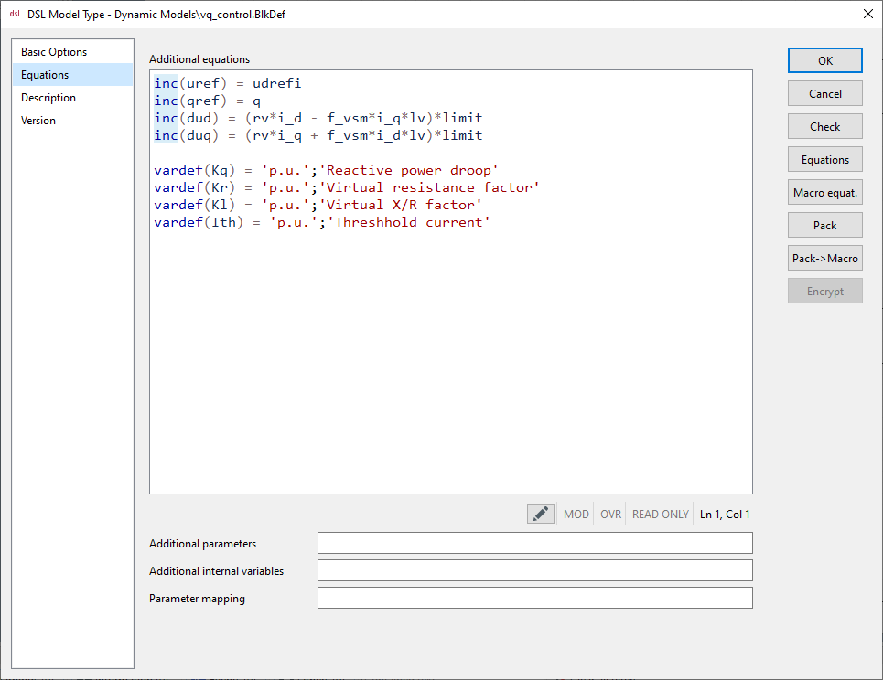
System level control – AC voltage control

Slide 58

DC link
Based on power equation instead of current equation
$$\frac{1}{ω_{b}}\frac{C_{DC}}{2}\frac{dv_{DC}^{2}}{dt}=p_{ext}−p_{c}$$

Slide 59
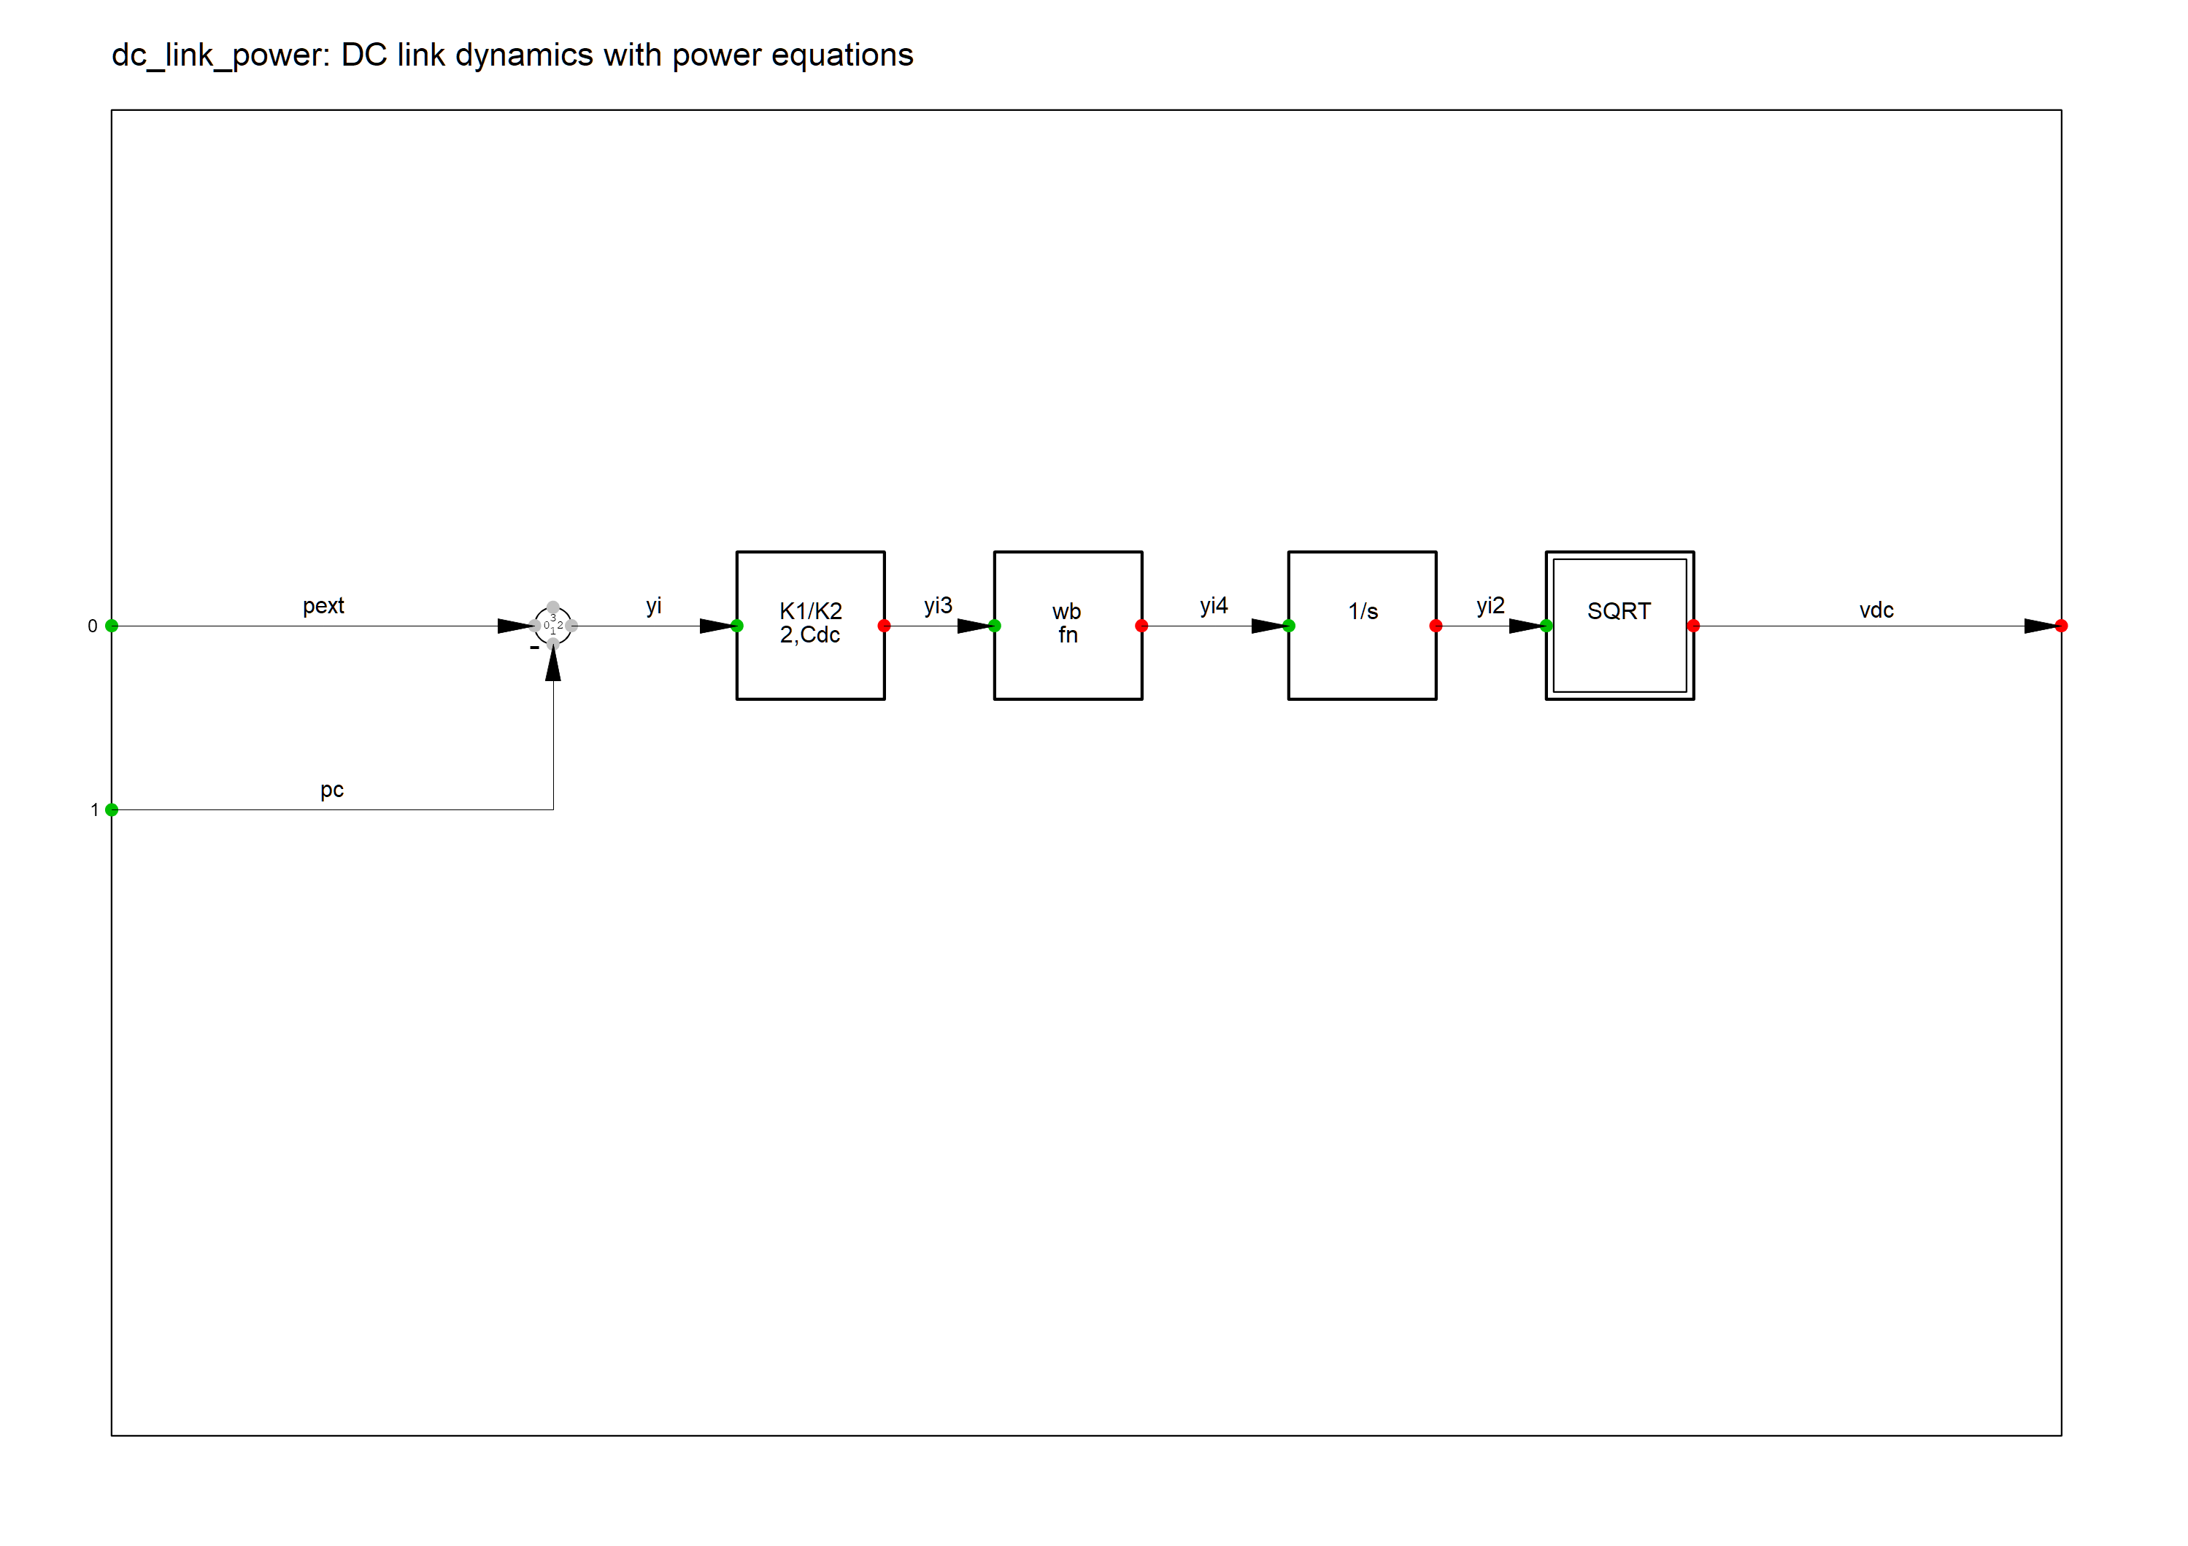
DC link

Slide 60
DC link

Slide 61
DC link

Slide 62
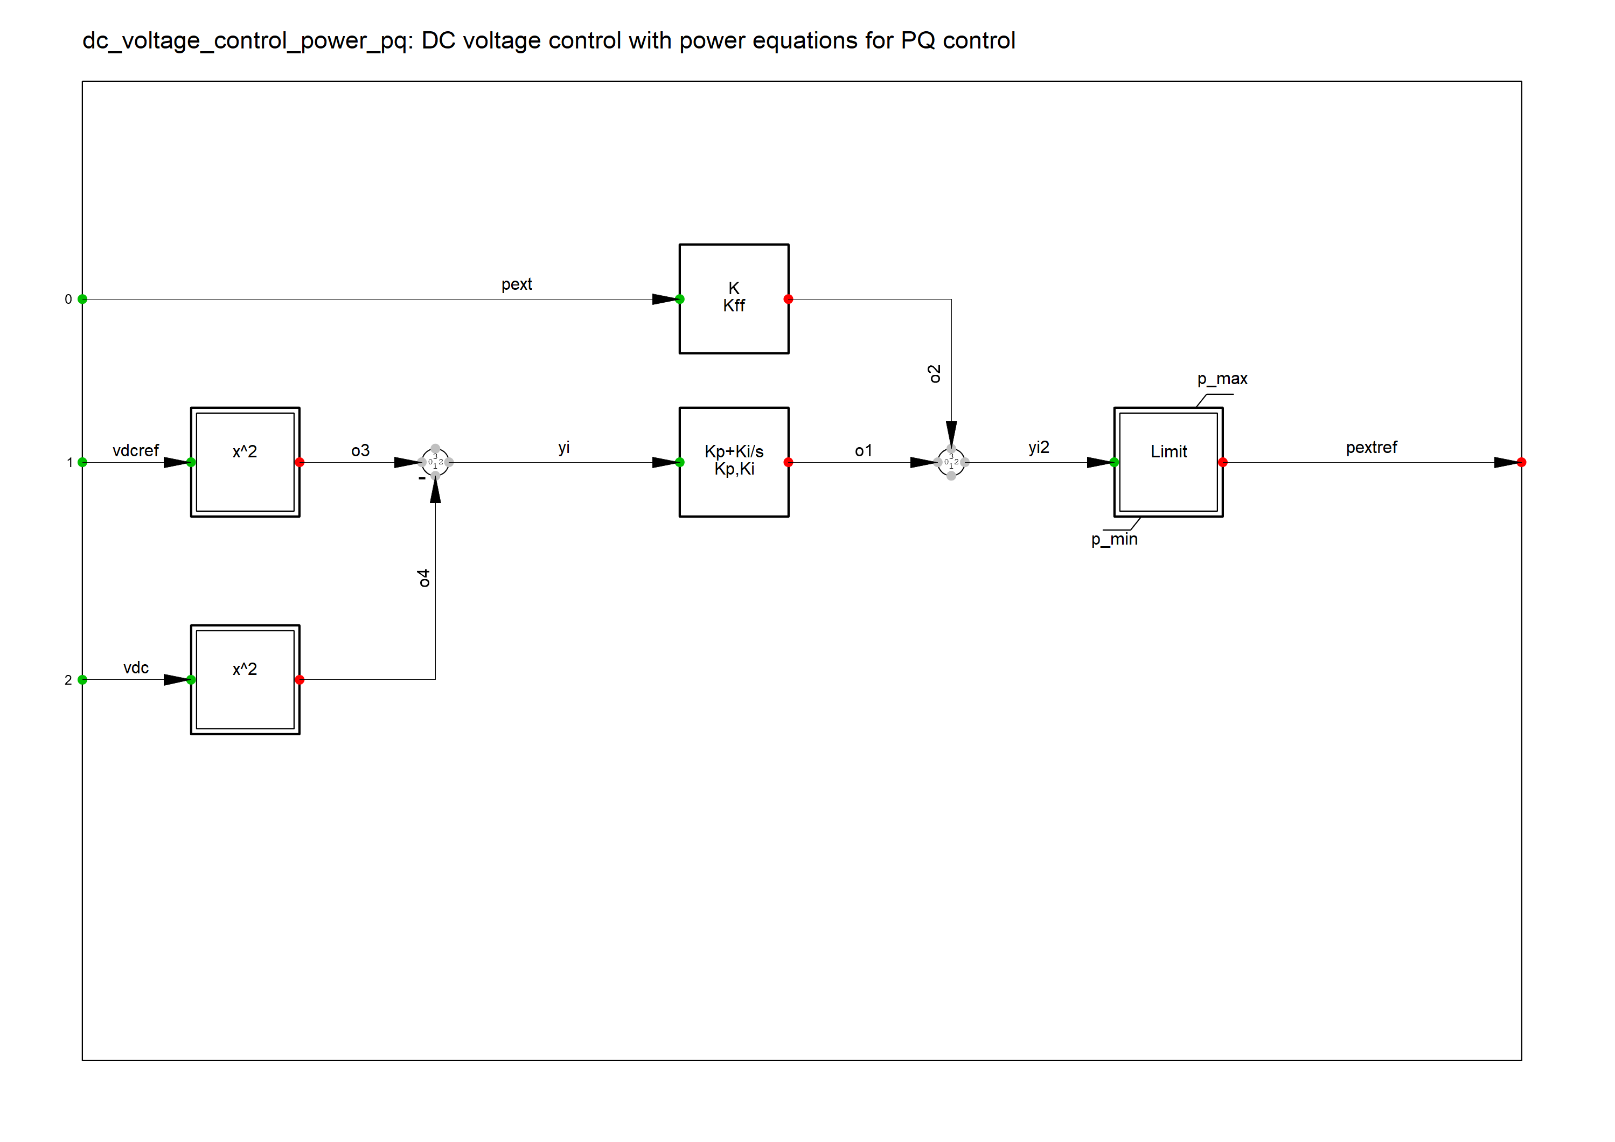
DC voltage control

Slide 63
DC voltage control

Slide 64
DC voltage control

Slide 65
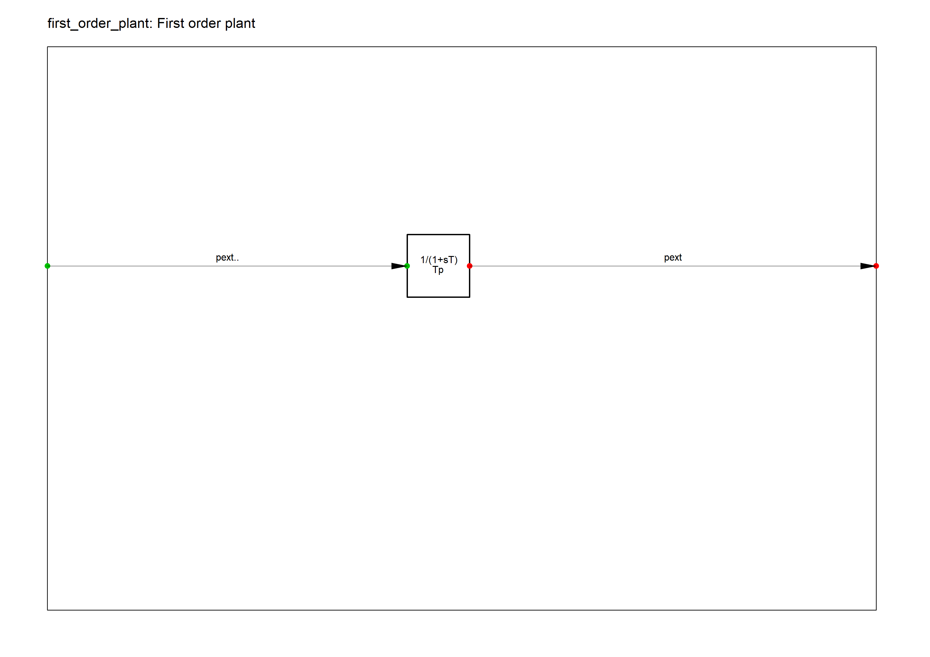
Plant dynamics

Slide 66
Plant dynamics

Slide 67
Plant dynamics

Slide 68
Measurement devices
Converter power measurement
Converter current measurement
Filter voltage measurement
Grid power measurement
Grid current measurement

Slide 69
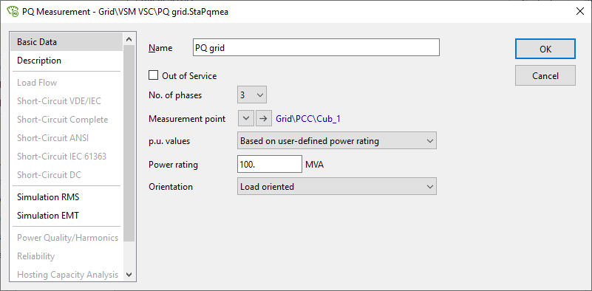
Grid power measurement

Slide 70
Converter power measurement

Slide 71
Filter voltage measurement

Slide 72
Converter current measurement

Slide 73
Grid current measurement
RMS value of base current due to the way PF handles quantities

Slide 74
Model initialization
Generally, output-to-input
Sometimes input-to-output and potential deadlocks need to be taken care of
Load flow will initialize Static generator input variables u1r_in, u1i_in
Load flow will initialize voltages, currents and PLL phase angle measurements
Internal VSM angle theta is the output of the VSM slot initialized manually

Slide 75
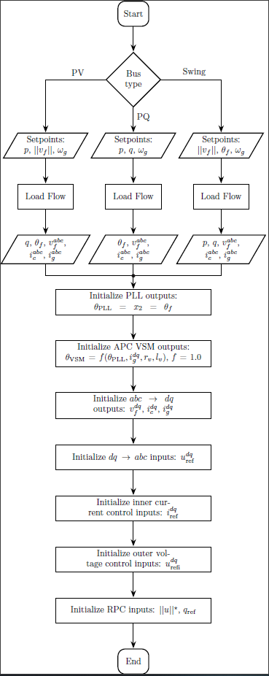
Model initializaton

Slide 76
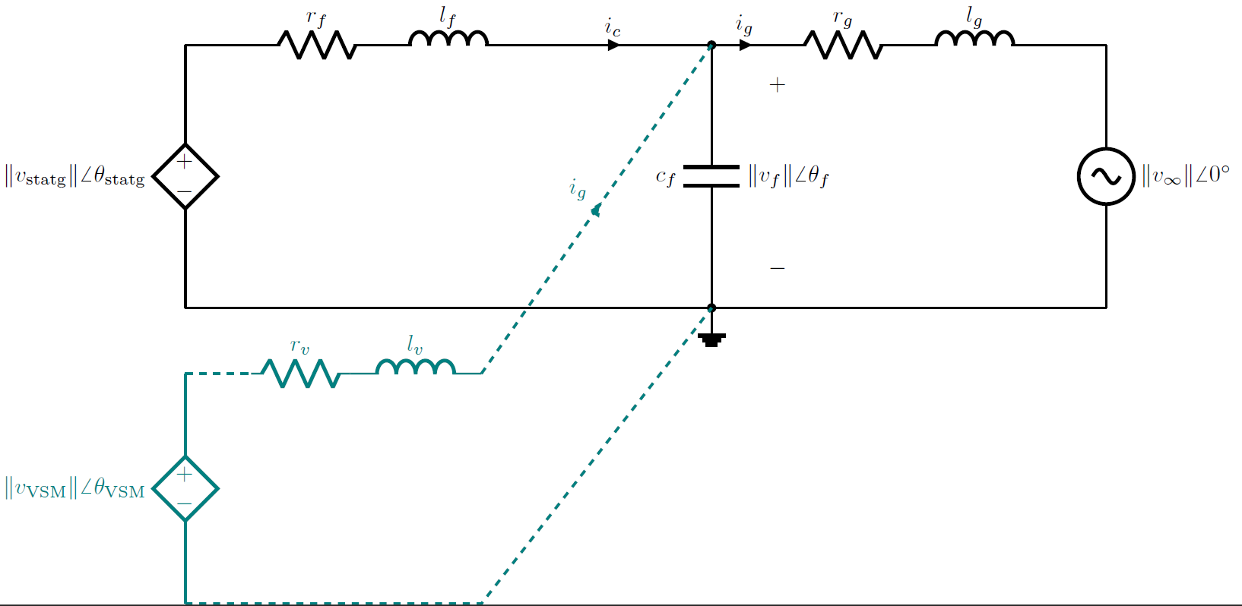
Model initializaton

Slide 77
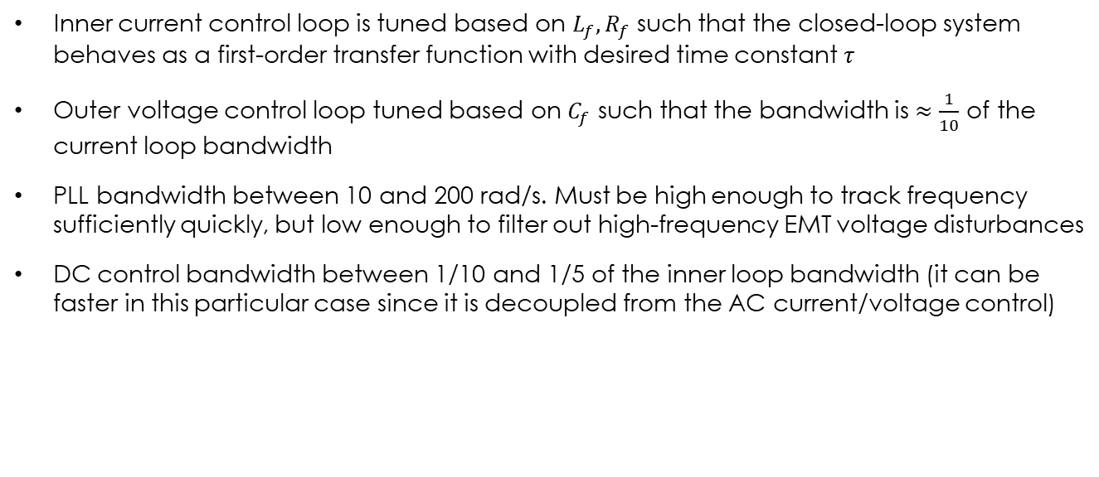
Controller tuning
Inner current control loop is tuned based on $L_{f}, R_{f}$ such that the closed-loop system behaves as a first-order transfer function with desired time constant $τ$
Outer voltage control loop tuned based on $C_{f}$ such that the bandwidth is $≈\frac{1}{10}$ of the current loop bandwidth
PLL bandwidth between 10 and 200 rad/s. Must be high enough to track frequency sufficiently quickly, but low enough to filter out high-frequency EMT voltage disturbances
DC control bandwidth between 1/10 and 1/5 of the inner loop bandwidth (it can be faster in this particular case since it is decoupled from the AC current/voltage control)

Slide 78
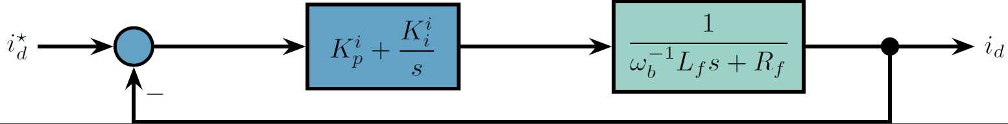
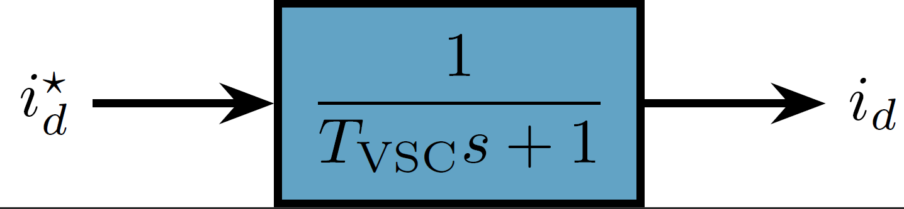
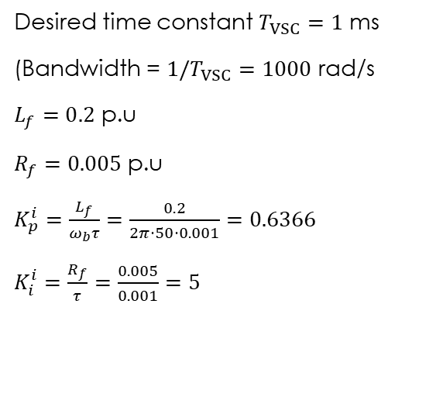
Current controller
Desired time constant $T_{VSC}=1$ ms
(Bandwidth = ${1/T}_{VSC}=1000$ rad/s
$L_{f}=0.2$ p.u
$R_{f}=0.005$ p.u
$K_{p}^{i}=\frac{L_{f}}{ω_{b}τ}=\frac{0.2}{2π⋅50⋅0.001}=0.6366$
$K_{i}^{i}=\frac{R_{f}}{τ}=\frac{0.005}{0.001}=5$

Slide 79
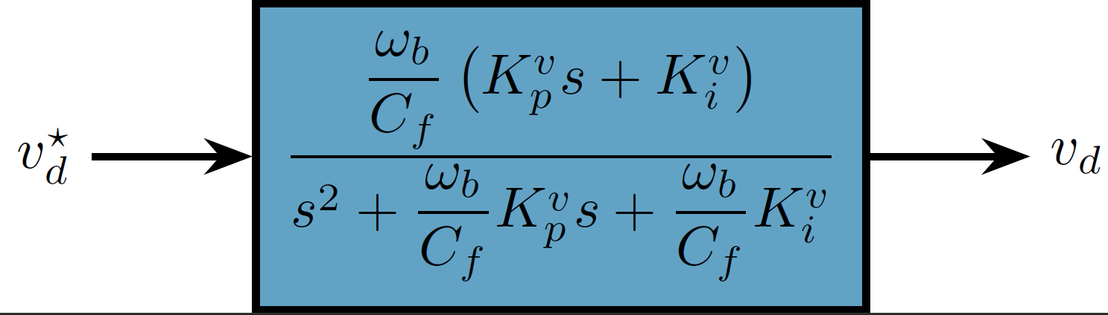
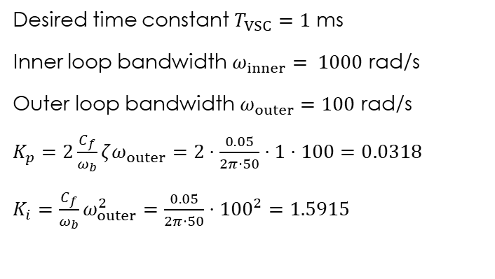


Voltage controller
Desired time constant $T_{VSC}=1$ ms
Inner loop bandwidth $ω_{inner}= 1000$ rad/s
Outer loop bandwidth $ω_{outer}=100$ rad/s
$K_{p}=2\frac{C_{f}}{ω_{b}}ζω_{outer}=2⋅\frac{0.05}{2π⋅50}⋅1⋅100=0.0318$
$K_{i}=\frac{C_{f}}{ω_{b}}ω_{outer}^{2}=\frac{0.05}{2π⋅50}⋅{100}^{2}=1.5915$
$$\frac{ω_{b}C_{f}^{−1}(K_{p}^{v}s+K_{i}^{v})}{s^{2}+ω_{b}C_{f}^{−1}K_{p}^{v}s+ω_{b}C_{f}^{−1}K_{i}^{v}}=\frac{2ζω_{n}s+ω_{n}^{2}}{s^{2}+2ζω_{n}s+ω_{n}^{2}}$$
$ζ$ – Desired damping

Slide 80
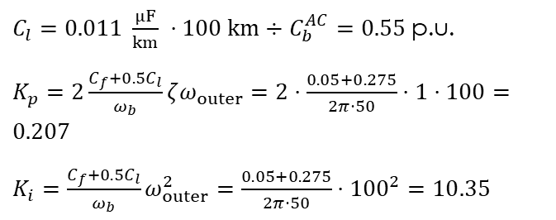
Voltage controller
Performance and tuning strongly depends on grid-connected or isolated model of operation
Grid-connected: Disable voltage feed-forward at the output of inner current controller (ffv = 0)
Isolated mode: Enable voltage feed-forward at the output of inner current controller (ffv = 1) and retune K_{p} and K_{i} to take into account line capacitance if significant
$C_{l}=0.011 \frac{μF}{km} ⋅100 km÷C_{b}^{AC}=0.55$ p.u.
$K_{p}=2\frac{C_{f}+{0.5C}_{l}}{ω_{b}}ζω_{outer}=2⋅\frac{0.05+0.275}{2π⋅50}⋅1⋅100=0.207$
$K_{i}=\frac{C_{f}+{0.5C}_{l}}{ω_{b}}ω_{outer}^{2}=\frac{0.05+0.275}{2π⋅50}⋅{100}^{2}=10.35$

Slide 81
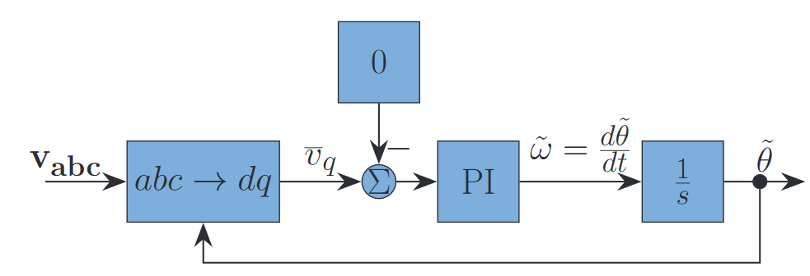
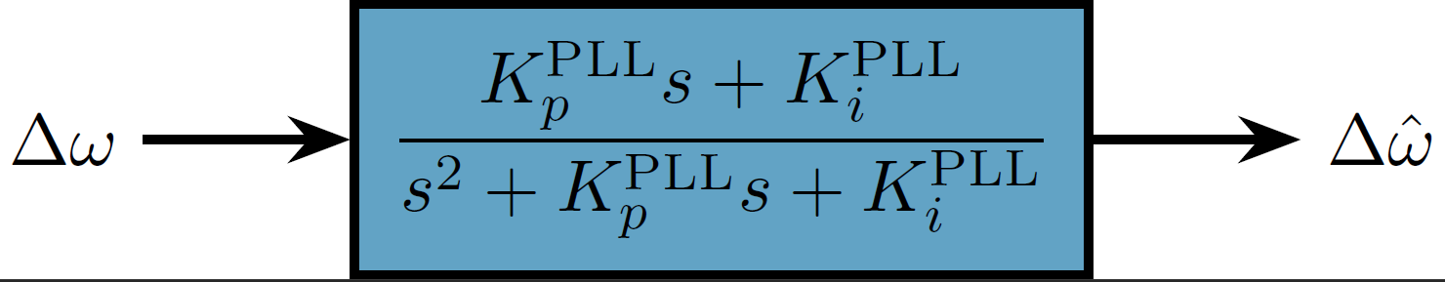


PLL controller
For closed-loop bandwidth $ω_{PLL}=20$rad/s and $ζ=2$ (arbitrary values):
$K_{p}^{PLL}=2ζω_{PLL}=2⋅2⋅20=80$
$K_{i}^{PLL}=ω_{PLL}^{2}=400$
$$\frac{K_{p}^{PLL}s+K_{i}^{PLL}}{s^{2}+K_{p}^{PLL}s+K_{i}^{PLL}}=\frac{2ζω_{n}s+ω_{n}^{2}}{s^{2}+2ζω_{n}s+ω_{n}^{2}}$$

Slide 82

PLL controller
PLL frequency tracking performance to a step change of infinite bus frequency

Slide 83



DC controller and DC link
For closed-loop bandwidth $ω_{DC}=350$rad/s and $ζ=1$ (arbitrary values):
$K_{p}^{DC}=2ζ\frac{C_{DC}}{2ω_{b}}ω_{DC}=2⋅1⋅\frac{1}{2⋅100π}⋅350=1.1$
$K_{i}^{DC}={\frac{C_{DC}}{2ω_{b}}ω}_{DC}^{2}=195$

Slide 84

DC controller and DC link
DC voltage reference tracking

Slide 85

Time-domain simulation setup

Slide 86
Time-domain simulation setup

Slide 87
Time-domain simulation setup

Slide 88

Grid-connected: Power reference tracking

Slide 89

Grid-connected: 3PH short-circuit at 50%

Slide 90

Loss of external grid (Transition to island mode)

Slide 91
Isolated mode: Load increase

Slide 92

Isolated mode: Voltage reference increase
Slow and poor tracking because the controller was tuned to the grid-connected operation

Slide 93

Isolated mode: Voltage reference increase
Enabling PCC voltage feed-forward in current control
Retuning Kp and Ki of voltage controller to consider Cline

Slide 94
Final remarks
Make sure you are consistent with mathematical transformations (per-unit, dq orientation, line/phase + peak/rms values, current and power directions)
Sensitivity of grid-forming control to short-circuit faults: standard current reference saturation can result in instability
All the control system are applicable to other grid-forming controls (droop, synchronverter, etc.)
DC link dynamics have no effect in the presented averaged model – grid-forming synchronization based on DC link imbalance requires appropriate design

Slide 95
Literature
B. Barac, M. Krpan, T. Capuder, and I. Kuzle, “Modeling and Initialization of a Virtual Synchronous Machine for Power System Fundamental Frequency Simulations,” IEEE Access, vol. 9, pp. 160116–160134, 2021, doi: 10.1109/ACCESS.2021.3130375.
S. D’Arco, J. A. Suul, and O. B. Fosso, “A Virtual Synchronous Machine implementation for distributed control of power converters in SmartGrids,” Electric Power Systems Research, vol. 122, pp. 180–197, May 2015, doi: 10.1016/J.EPSR.2015.01.001.
M. Krpan, I. Erceg, I. Kuzle, and H. Pandzic, “Three-Phase SRF PLL Model for System Frequency Response Studies in Low-Inertia Systems,” in 2022 IEEE PES Innovative Smart Grid Technologies - Asia (ISGT Asia), IEEE, Nov. 2022, pp. 155–159. doi: 10.1109/ISGTASIA54193.2022.10003520.
G. Denis, T. Prevost, M. S. Debry, F. Xavier, X. Guillaud, and A. Menze, “The migrate project: The challenges of operating a transmission grid with only inverter-based generation. A grid-forming control improvement with transient current-limiting control,” IET Renewable Power Generation, vol. 12, no. 5, pp. 523–529, Apr. 2018, doi: 10.1049/IET-RPG.2017.0369/CITE/REFWORKS.
G. Denis, T. Prevost, P. Panciatici, X. Kestelyn, F. Colas and X. Guillaud, "Improving robustness against grid stiffness, with internal control of an AC voltage-controlled VSC," 2016 IEEE Power and Energy Society General Meeting (PESGM), Boston, MA, USA, 2016, pp. 1-5, doi: 10.1109/PESGM.2016.7741341.
A. D. Paquette and D. M. Divan, "Virtual Impedance Current Limiting for Inverters in Microgrids With Synchronous Generators," in IEEE Transactions on Industry Applications, vol. 51, no. 2, pp. 1630-1638, March-April 2015, doi: 10.1109/TIA.2014.2345877.
A. Yazdani and R. Iravani, Voltage-sourced converters in power systems: modeling, control, and applications. John Wiley & Sons, 2010.
M. Liserre, F. Blaabjerg, and S. Hansen, “Design and control of an LCL-filter-based three-phase active rectifier,” IEEE Transactions on Industry Applications, vol. 41, no. 5, pp. 1281–1291, Sep. 2005, doi: 10.1109/TIA.2005.853373.
M. Liserre, F. Blaabjerg, and A. Dell’aquila, “Step-by-step design procedure for a grid-connected three-phase PWM voltage source converter,” http://dx.doi.org/10.1080/00207210412331306186, vol. 91, no. 8, pp. 445–460, Aug. 2007, doi: 10.1080/00207210412331306186.
P. Channegowda and V. John, “Filter Optimization for Grid Interactive Voltage Source Inverters,” IEEE Transactions on Industrial Electronics, vol. 57, no. 12, pp. 4106–4114, Dec. 2010, doi: 10.1109/TIE.2010.2042421.

Slide 96

Material and info
PowerFactory model:
https://applygit.zvne.fer.hr/mkrpan/powertech-belgrade-tutorial-vsm.git
E-mail:
matej.krpan@fer.hr

